Slide 1
QSYS Architecture (MINERVA Cryogenic System)
Daniel Berkowitz (MDB-ATS-ACR)
ALX-40629944

Slide 2
MINERVA’s Cryo-Architecture
QSYS
Naming Convention (SCK-CEN/42055443)
MINERVA Cryogenic System
Cryogenic Supply System (CSS)
Infrastructure
Cryoplant
Cryogenic Distribution System
Storages
Warm compressor stations
Refrigerator cold-box
Cryogenic transfer lines
Cryogenic Cell
Refrigerator cold boxes
Warm compressor station
Gas management
He purification system
He recovery system
Warm Piping System
Cryogenic distribution boxes
Main Cryogenic Line (QRB ↔ QVB)
Cryomodule’s valve-box
HP gaseous warm He storage (GHe)
Liquid He storage (LHe)
Liquid N2 storage (LN2)
General piping
Cryomodules
End-box
Warm Piping MAC
Cryogenic Users
QINFRA
QPLANT
QDIST
QCELL
_S_
_G_
_P _
_C_
_R_
_L_
_V_
WSH
[Not Baseline]
WGP
WPS
WCS
QRB
QLM
QVB
QM
QSH
[Not Baseline]
WGR
Compressor skids (SP, LP, and MP)
Gas regulation panel
Oil removal system
Dryers
Cold Compressors
Main process section (HX, turbines, etc)
Warm-section panel
QVE
LINAC Configuration:
24 QMs: initial / current implementation.
30 QMs: design point for CRYOSYS.
[Not Baseline]
[scope NFS]
WPM
Cryogenic Distribution Backbone (QDB)
WGR-PS: for LINAC (ACC PS)
WGR-MAC: for MAC
[Not Baseline]
QSN
Supply lines (U)
Recovery lines (W)
SV lines (S)
Vent lines (V)
To assist pre-cooling and/or purification units
- Incl. transfer lines
For aiding the main process (buffering)
- Incl. transfer lines
Utilities ACC
Electrical power
Compressed air
Cooling water
HVAC
Supporting Systems
Insulation Vacuum
Controls for QCELL & QDIST
Controls for QPLANT
NA.ESxx
NA.PS01
NA.PS05
NA.HV03
ACC PS/INVAC
CIS/xxx Column
CIS/Cryo Column

Slide 3
MINERVA’s Cryo-Architecture
QSYS
Naming Convention (SCK-CEN/42055443)
MINERVA Cryogenic System
Cryogenic Supply System (CSS)
Infrastructure
Cryoplant
Cryogenic Distribution System
Storages
Warm compressor stations
Refrigerator cold-box
Cryogenic transfer lines
Cryogenic Cell
Refrigerator cold boxes
Warm compressor station
Gas management
He purification system
He recovery system
Warm Piping System
Cryogenic distribution boxes
Main Cryogenic Line (QRB ↔ QVB)
Cryomodule’s valve-box
HP gaseous warm He storage (GHe)
Liquid He storage (LHe)
Liquid N2 storage (LN2)
General piping
Cryomodules
End-box
Warm Piping MAC
Cryogenic Users
QINFRA
QPLANT
QDIST
QCELL
_S_
_G_
_P _
_C_
_R_
_L_
_V_
WSH
[Not Baseline]
WGP
WPS
WCS
QRB
QLM
QVB
QM
QSH
[Not Baseline]
WGR
Compressor skids (SP, LP, and MP)
Gas regulation panel
Oil removal system
Dryers
Cold Compressors
Main process section (HX, turbines, etc)
Warm-section panel
QVE
LINAC Configuration:
24 QMs: initial / current implementation.
30 QMs: design point for CRYOSYS.
[Not Baseline]
[scope NFS]
WPM
Cryogenic Distribution Backbone (QDB)
WGR-PS: for LINAC (ACC PS)
WGR-MAC: for MAC
[Not Baseline]
QSN
Supply lines (U)
Recovery lines (W)
SV lines (S)
Vent lines (V)
Tender Package
Tender01
Tender02
Other Tenders
To assist pre-cooling and/or purification units
- Incl. transfer lines
For aiding the main process (buffering)
- Incl. transfer lines
Utilities ACC
Electrical power
Compressed air
Cooling water
HVAC
Supporting Systems
Insulation Vacuum
Controls for QCELL & QDIST
Controls for QPLANT
NA.ESxx
NA.PS01
NA.PS05
NA.HV03
ACC PS/INVAC
CIS/xxx Column
CIS/Cryo Column

Slide 4
MINERVA Cryogenic System (highly simplified)
Cryoplant & Infrastructure
WCS
QRB
WSH
WSH
WSH
QLM
WPS
Cryo Backbone
QVB
QVB
QVE
System lifecycle:
Design & Engineering
Procurement & Implementation
Prequalification & Testing
Installation & SAT
Cryomodules
QM
QM
QCELL

Slide 5
MINERVA Cryogenic System (highly simplified)
Cryoplant & Infrastructure
WCS
QRB
WSH
WSH
WSH
QLM
WPS
Cryo Backbone
QVB
QVB
QVE
Cryomodules
ALL GROUPED
QM
QM
QCELL

Slide 6
MINERVA Cryogenic System (highly simplified)
Cryoplant & Infrastructure
WCS
QRB
WSH
WSH
WSH
QLM
WPS
Cryo Backbone
QVB
QVB
QVE
Cryomodules
Partial – blue/orange/pink
QM
QM
QCELL

Slide 7
MINERVA Cryogenic System (highly simplified)
Cryoplant & Infrastructure
WCS
QRB
WSH
WSH
WSH
QLM
WPS
Cryo Backbone
QVB
QVB
QVE
Cryomodules
THINK_OK – blue/orange/pink
QM
QM
QCELL

Slide 8
MINERVA Cryogenic System (highly simplified)
Cryoplant & Infrastructure
WCS
QRB
WSH
WSH
WSH
QLM
WPS
Cryo Backbone
QVB
QVB
QVE
Cryomodules
SPLIT LAST QVB
QM
QM
QCELL

Slide 9
MINERVA Cryogenic System (highly simplified)
Cryoplant (QPLANT) & Infrastructure (QINFRA)
QLM
WPS
Cryogenic Backbone (QBD)
QVB
QVB
QVE
Cryomodules
BLACK and white – make paspartu
QM
QM
QCELL

Slide 10
MINERVA Cryogenic System (highly simplified)
Cryoplant (QPLANT) & Infrastructure (QINFRA)
QLM
WPS
Cryogenic Backbone (QBD)
QVB
QVB
QVE
Cryomodules
BLACK and white – make paspartu
QM
QM
QCELL

Slide 11
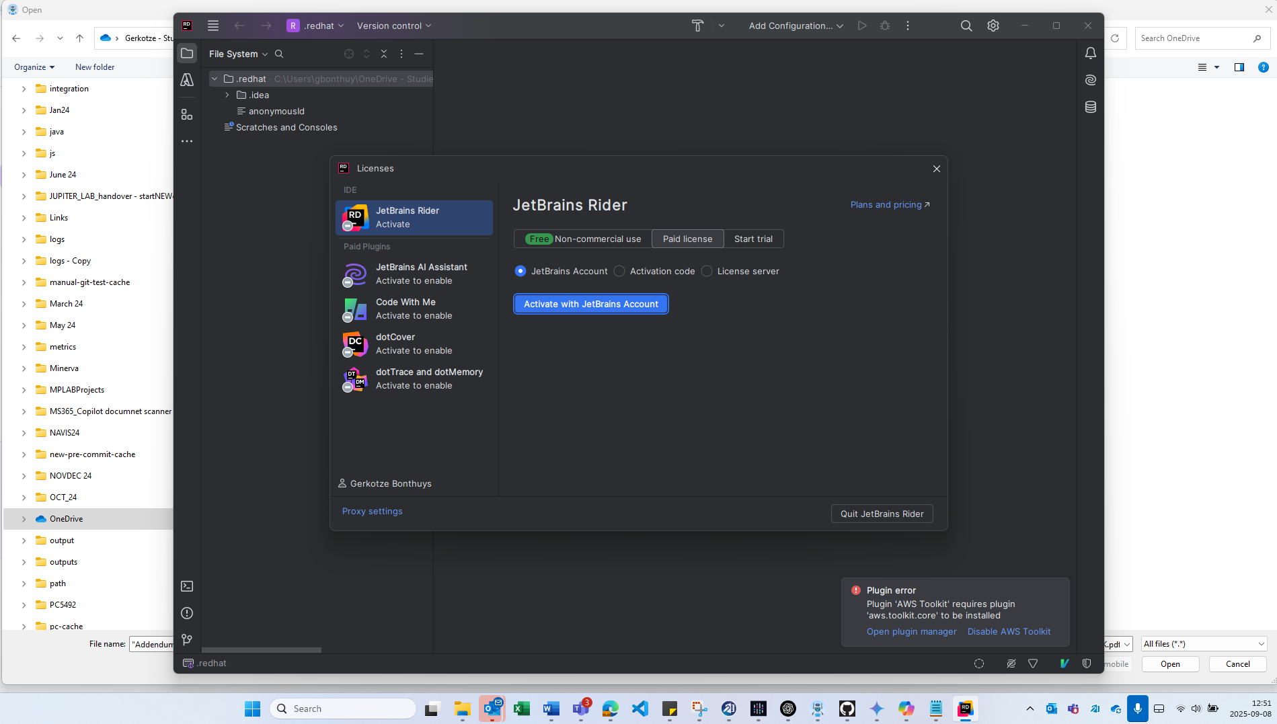

Slide 12
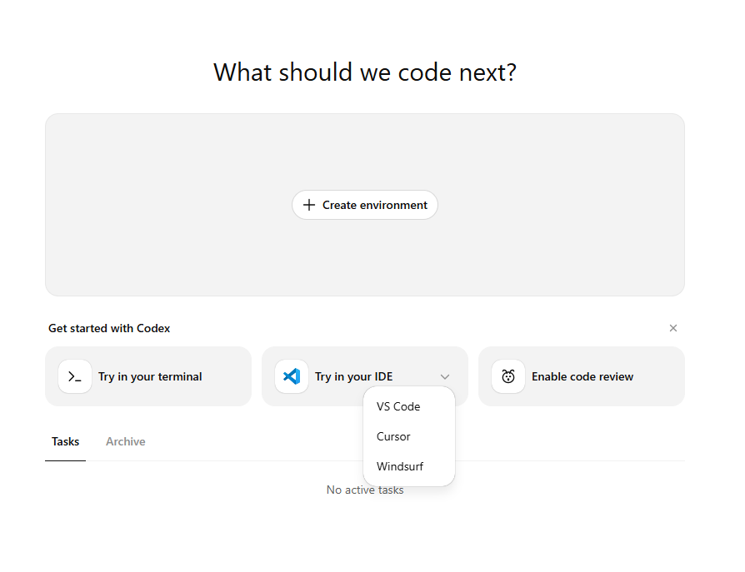

Slide 13
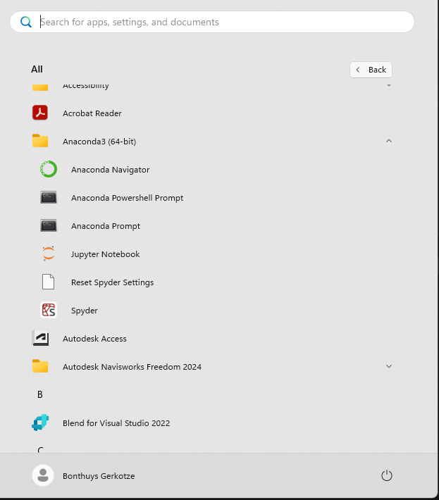
What is going to be MCP – where is MCP runinng – what is windsurf? USER wants ANACONDA via JUPYTER NOTEBOOK and SPYDER and CMB?

Slide 14
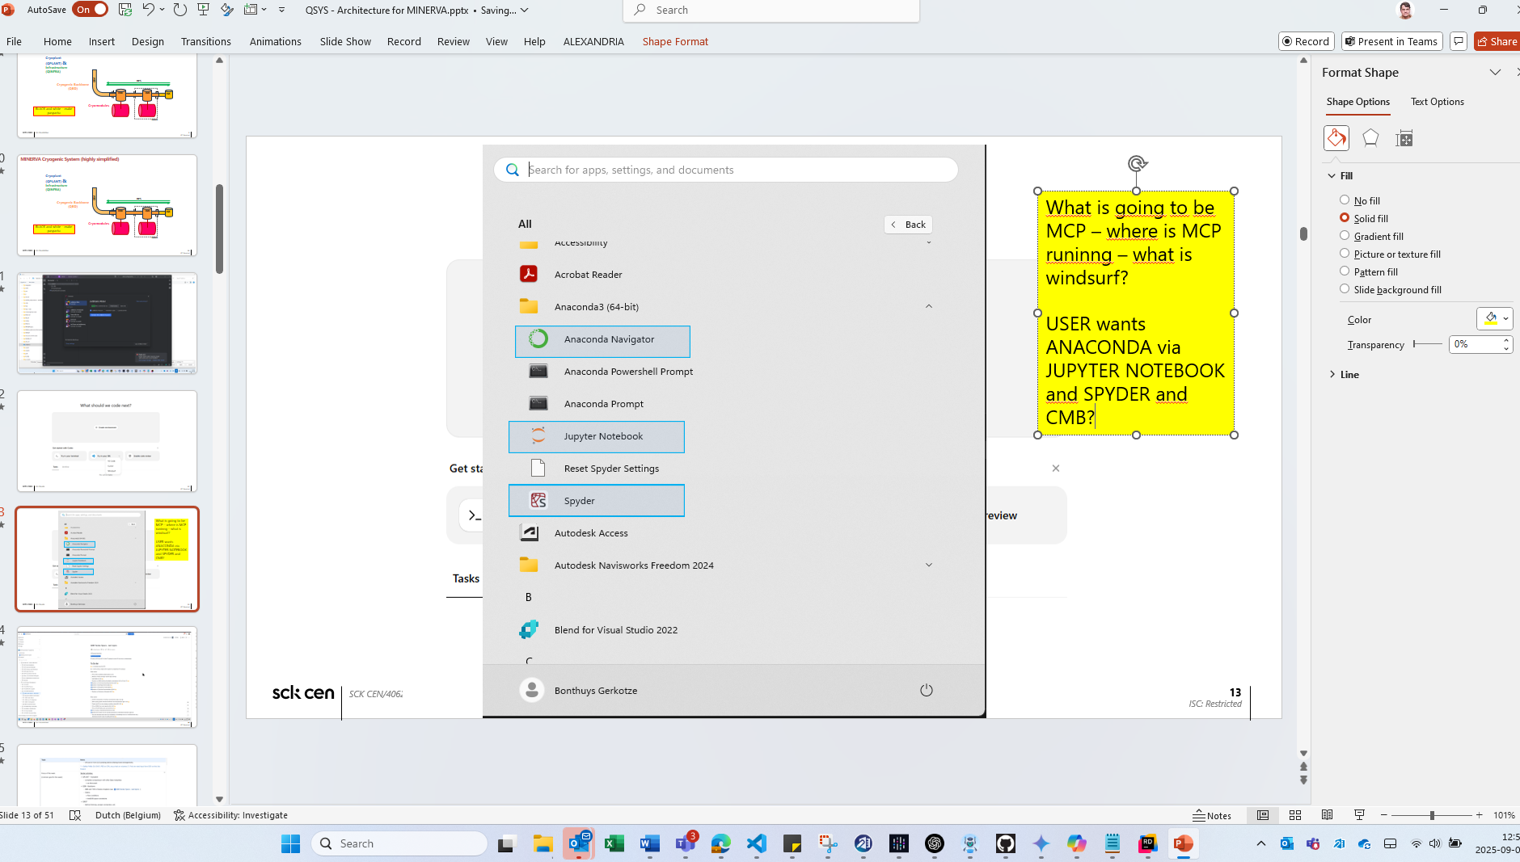

Slide 15
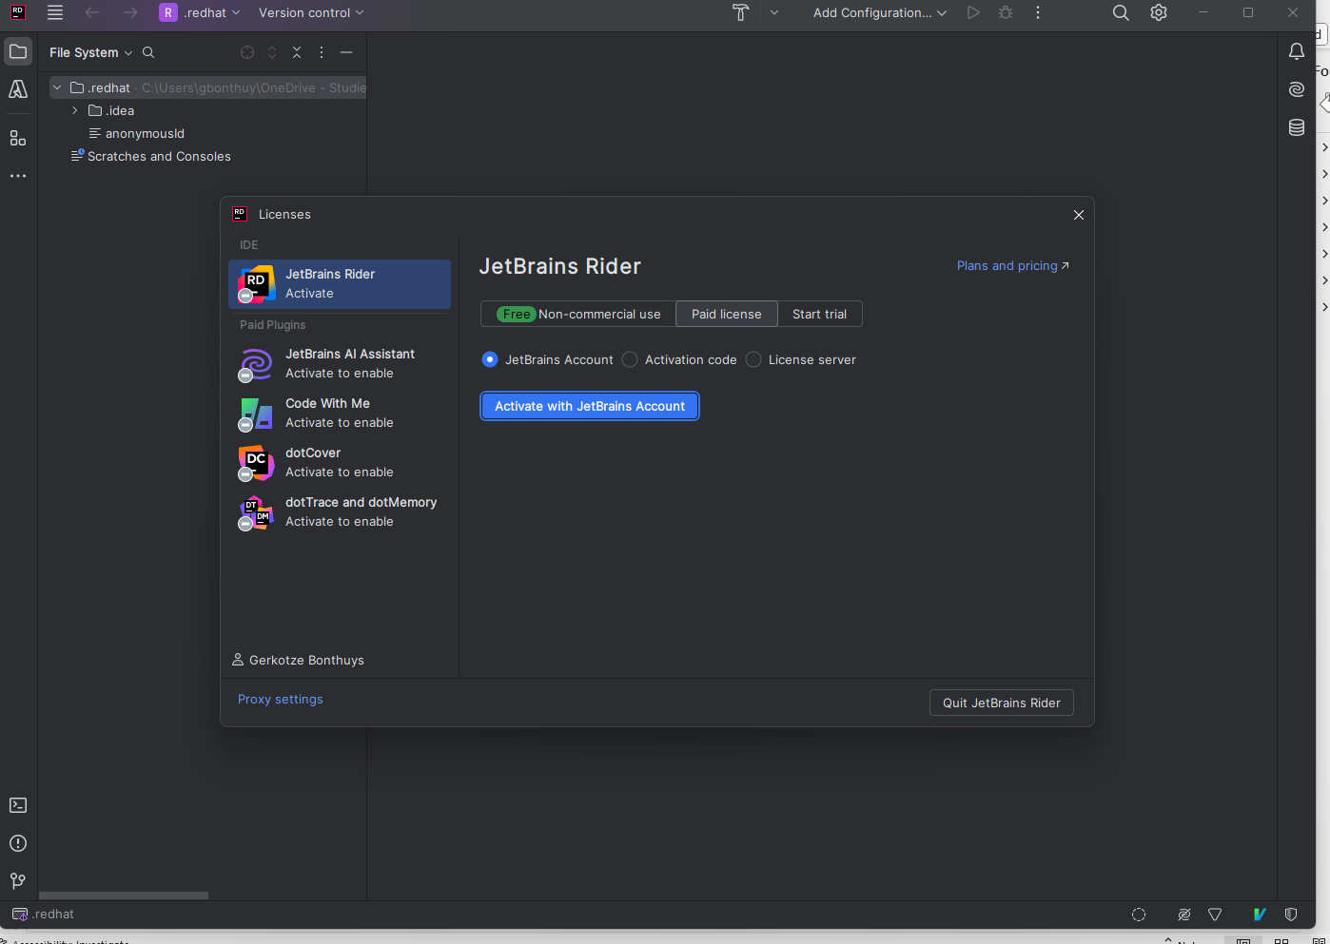

Slide 16
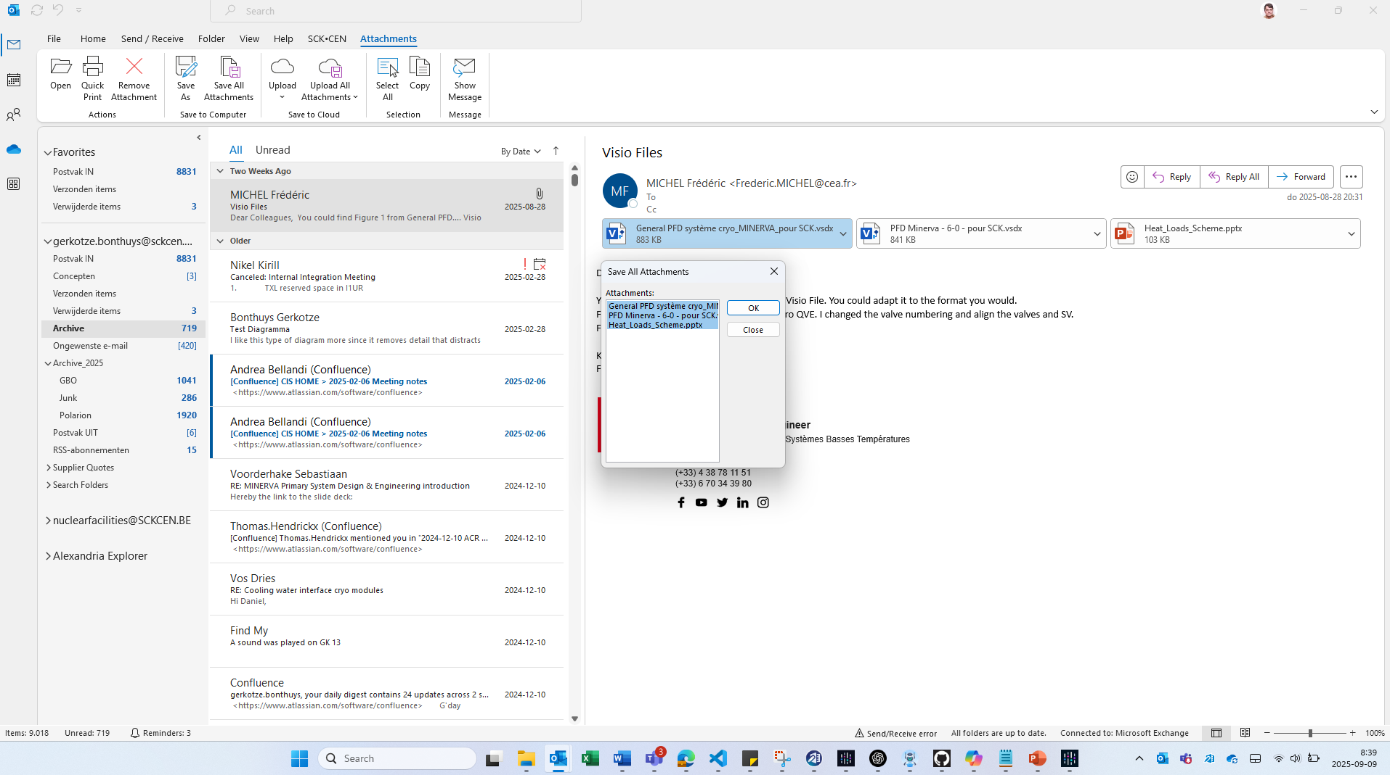

Slide 17
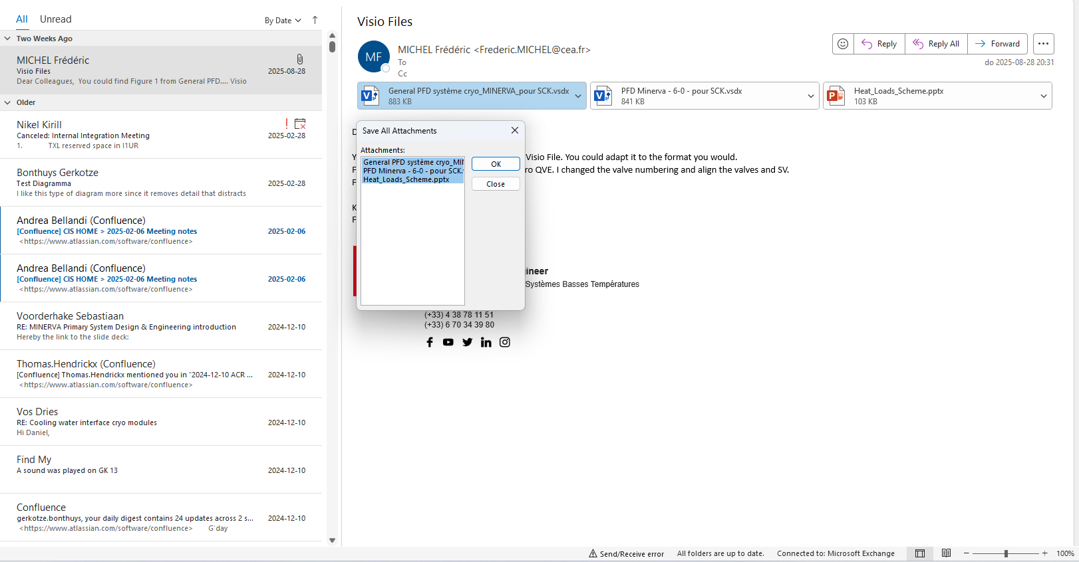

Slide 18
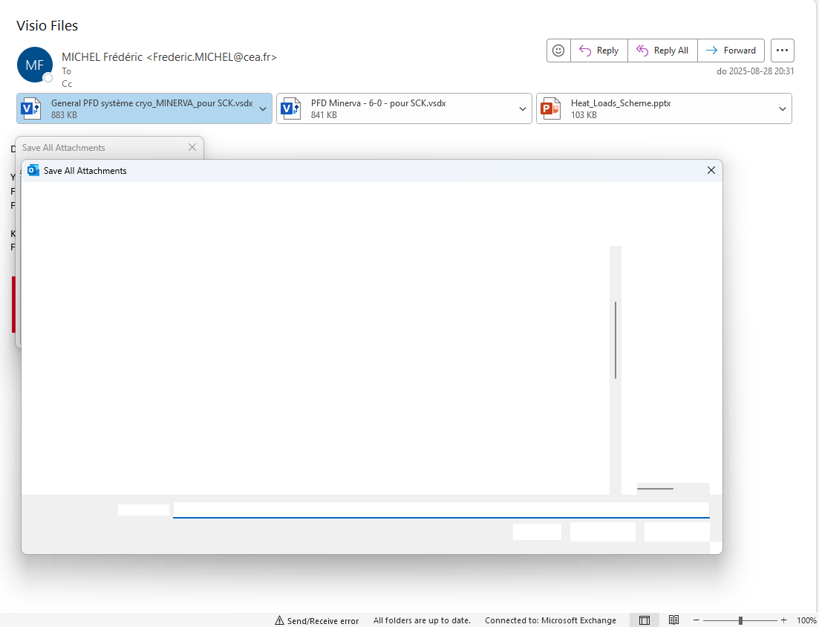
### 1 ### ***THIS is a nice size*** - the screenshot on PPT CANVAS – Presentation style or resized with vector graphics - maybe play a splash screen or interactive glob - Source markdown -- digital twin and digital mirror + Integration --- METADATA – TEXT BOX) mirror of pdf (out). # sequence and analyse text boxes - spell or grammar plural of text --as in text plural inside text boxes or ‘texts’ inside sequential text box --- text vs ‘texts’ ? # auto spell and style lint and build # recursive hooks(MAPPING_TOPICS). -- give a markdown version in markdown language - (bullet) - tab bullet (level) 1. NUMBERED ITEM 1.1 NUMBERERD ITEM # make the headings (some visual cue in typing – almost editor colour for types of thisn headins bullets parapha – or text box # use default font and style as per artefacts(generate USER slide deck from PPT (and other visual scans – but ALL PPT is primary – input sources – possible - # make a IDE and CMB handover – USER (typing environment – in ppt withing TEKST box and markdown and pdf and image(picture – only vector graphs accepted # USE style from PDF engine ## give index and reference (like ‘VS CODE’ (underlined files – to open in editor) – ## also file explorer update for INPUT – as resource INDEX – but made into easy accessible SQL – to only ‘download’ the real ‘full’ version ‘on demand’ # make all BASELINE() DOCUMENTS(), CANDIDATE(), INPUT(), OUTPUT(), HUMAN(), -VISUAL() drawings, artefacts and
### 2 ### Visual Styling and slinde content and layout orchestration based on USER library (mainly) pdf as starting point. ### 1. Purpose 2. Expected Outcome 3. Planned execution (optional) 4. Execution – step wise run, feedback, run feedback run (capture steps and current position in STEP sequence? - Keep ‘live update’ -- live_update: snapshot of current state(updated or last handover, manifest(optional – [CMB ←→[KEB] communication via GITHUB handover (orchestration of ### 2 ###

Slide 19
### 1 ### ***THIS is a nice size*** - the screenshot on PPT CANVAS – Presentation style or resized with vector graphics - maybe play a splash screen or interactive glob - Source markdown -- digital twin and digital mirror + Integration --- METADATA – TEXT BOX) mirror of pdf (out). # sequence and analyse text boxes - spell or grammar plural of text --as in text plural inside text boxes or ‘texts’ inside sequential text box --- text vs ‘texts’ ? # auto spell and style lint and build # recursive hooks(MAPPING_TOPICS). -- give a markdown version in markdown language - (bullet) - tab bullet (level) 1. NUMBERED ITEM 1.1 NUMBERERD ITEM
### 2 ### 1. Purpose 2. Expected Outcome 3. Planned execution (optional) 4. Execution – step wise run, feedback, run feedback run (capture steps and current position in STEP sequence? - Keep ‘live update’ -- live_update: snapshot of current state(updated or last handover, manifest(optional – [CMB ←→[KEB] communication via GITHUB handover (orchestration of ### 2 ###

Slide 20
### 1 ### ***THIS is a nice size*** - the screenshot on PPT CANVAS – Presentation style or resized with vector graphics - maybe play a splash screen or interactive glob - Source markdown -- digital twin and digital mirror + Integration --- METADATA – TEXT BOX) mirror of pdf (out). # sequence and analyse text boxes - spell or grammar plural of text --as in text plural inside text boxes or ‘texts’ inside sequential text box --- text vs ‘texts’ ? # auto spell and style lint and build # recursive hooks(MAPPING_TOPICS). -- give a markdown version in markdown language - (bullet) - tab bullet (level) 1. NUMBERED ITEM 1.1 NUMBERERD ITEM
### 2 ### 1. Purpose 2. Expected Outcome 3. Planned execution (optional) 4. Execution – step wise run, feedback, run feedback run (capture steps and current position in STEP sequence? - Keep ‘live update’ -- live_update: snapshot of current state(updated or last handover, manifest(optional – [CMB ←→[KEB] communication via GITHUB handover (orchestration of ### 2 ###

Slide 21
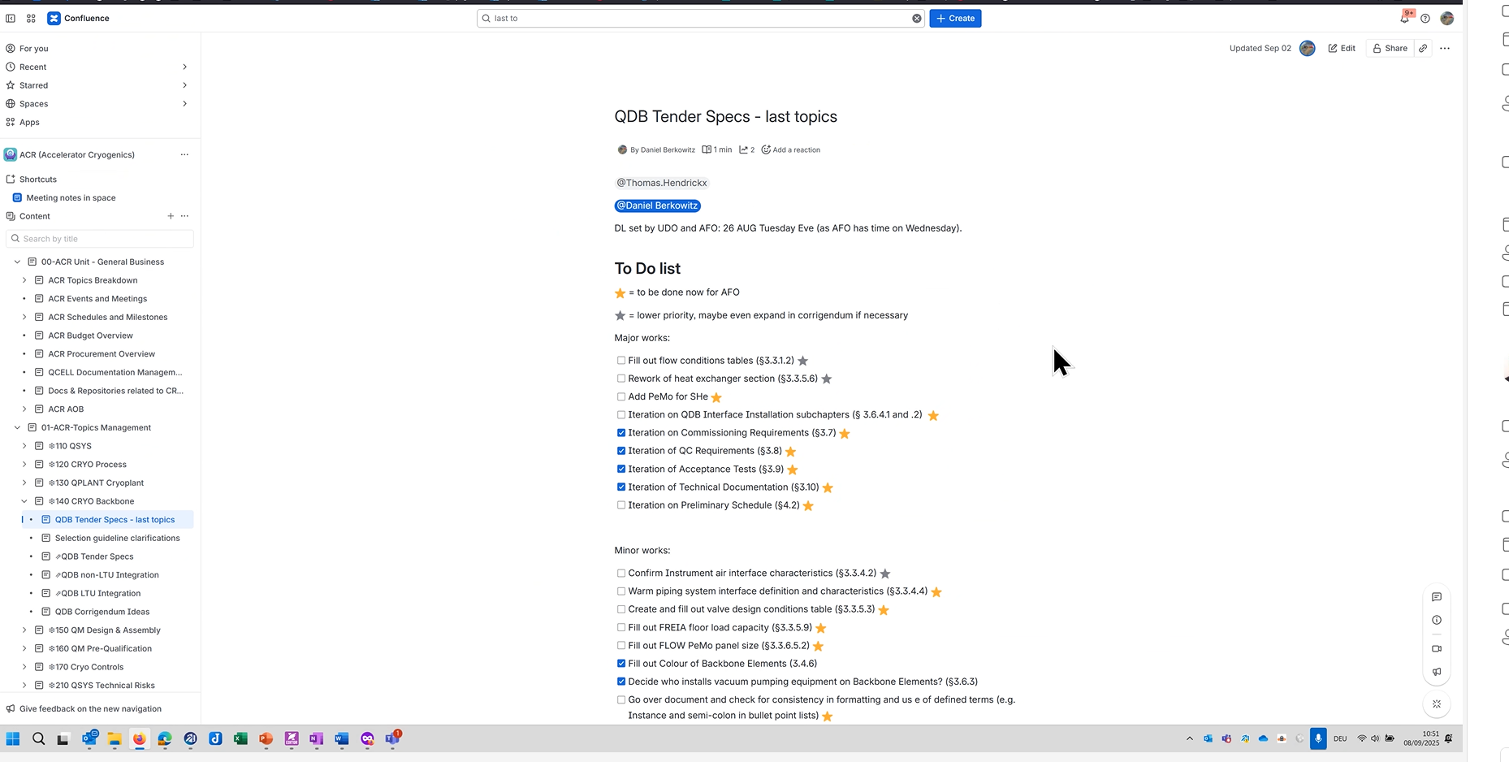

Slide 22
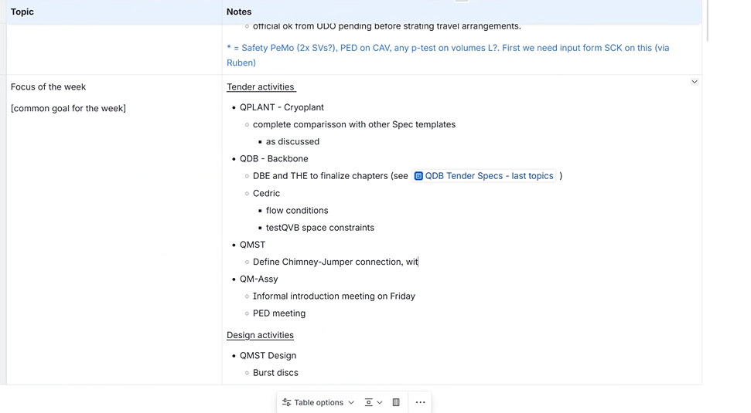

Slide 24
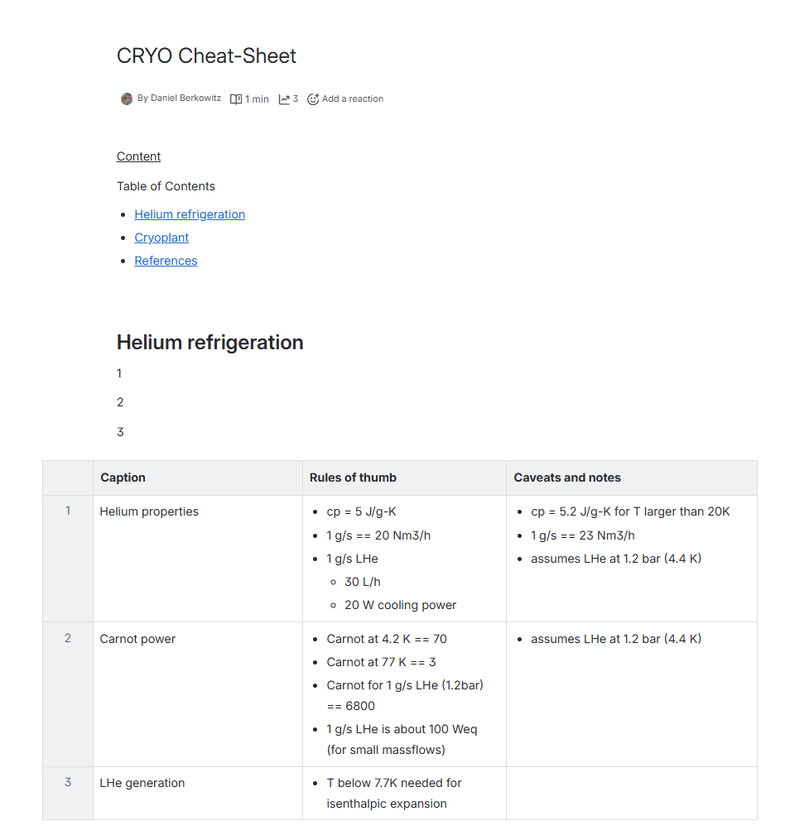

Slide 25
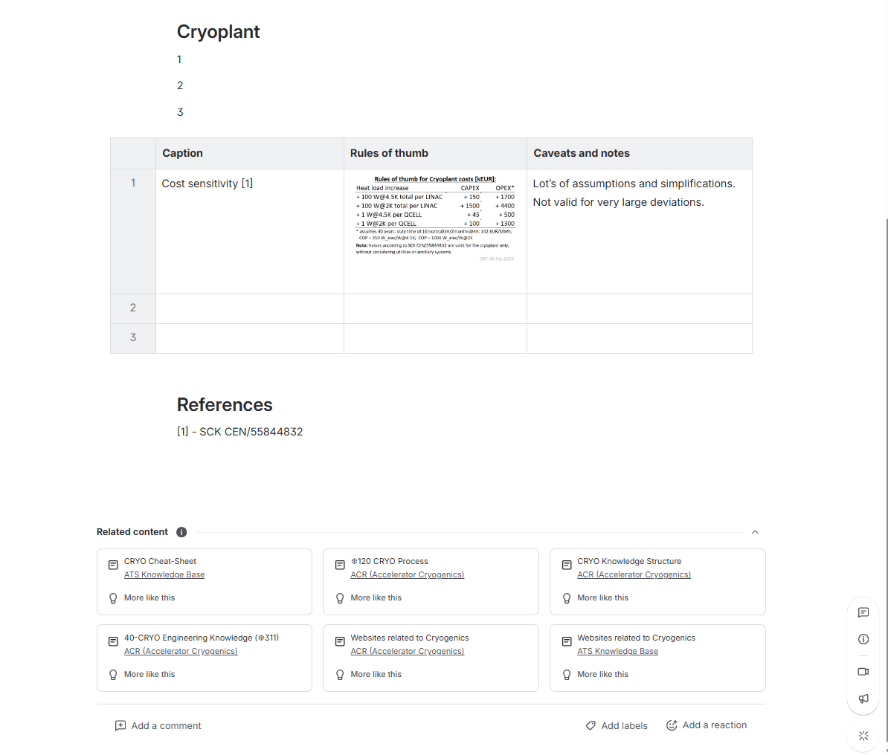


Slide 26
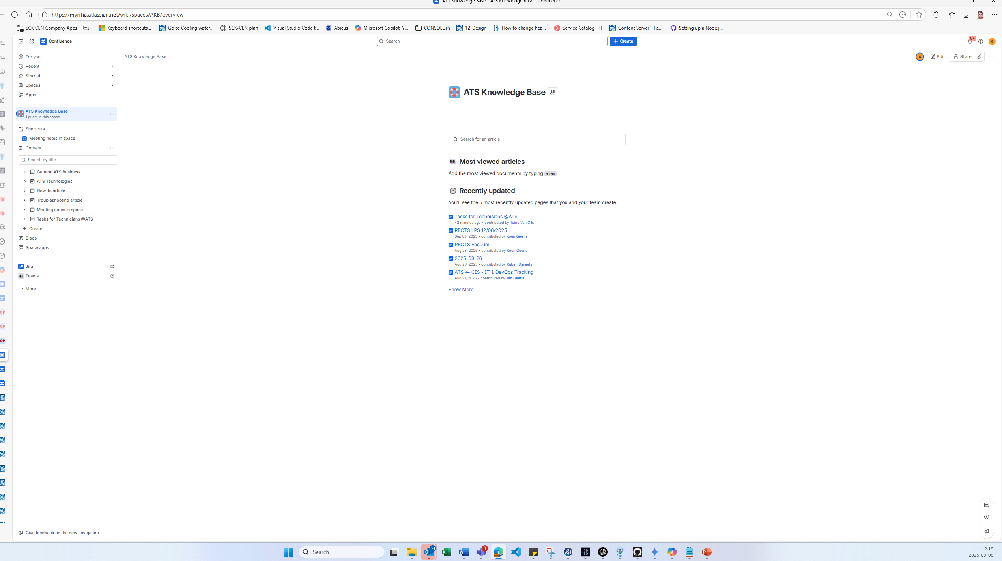

Slide 27
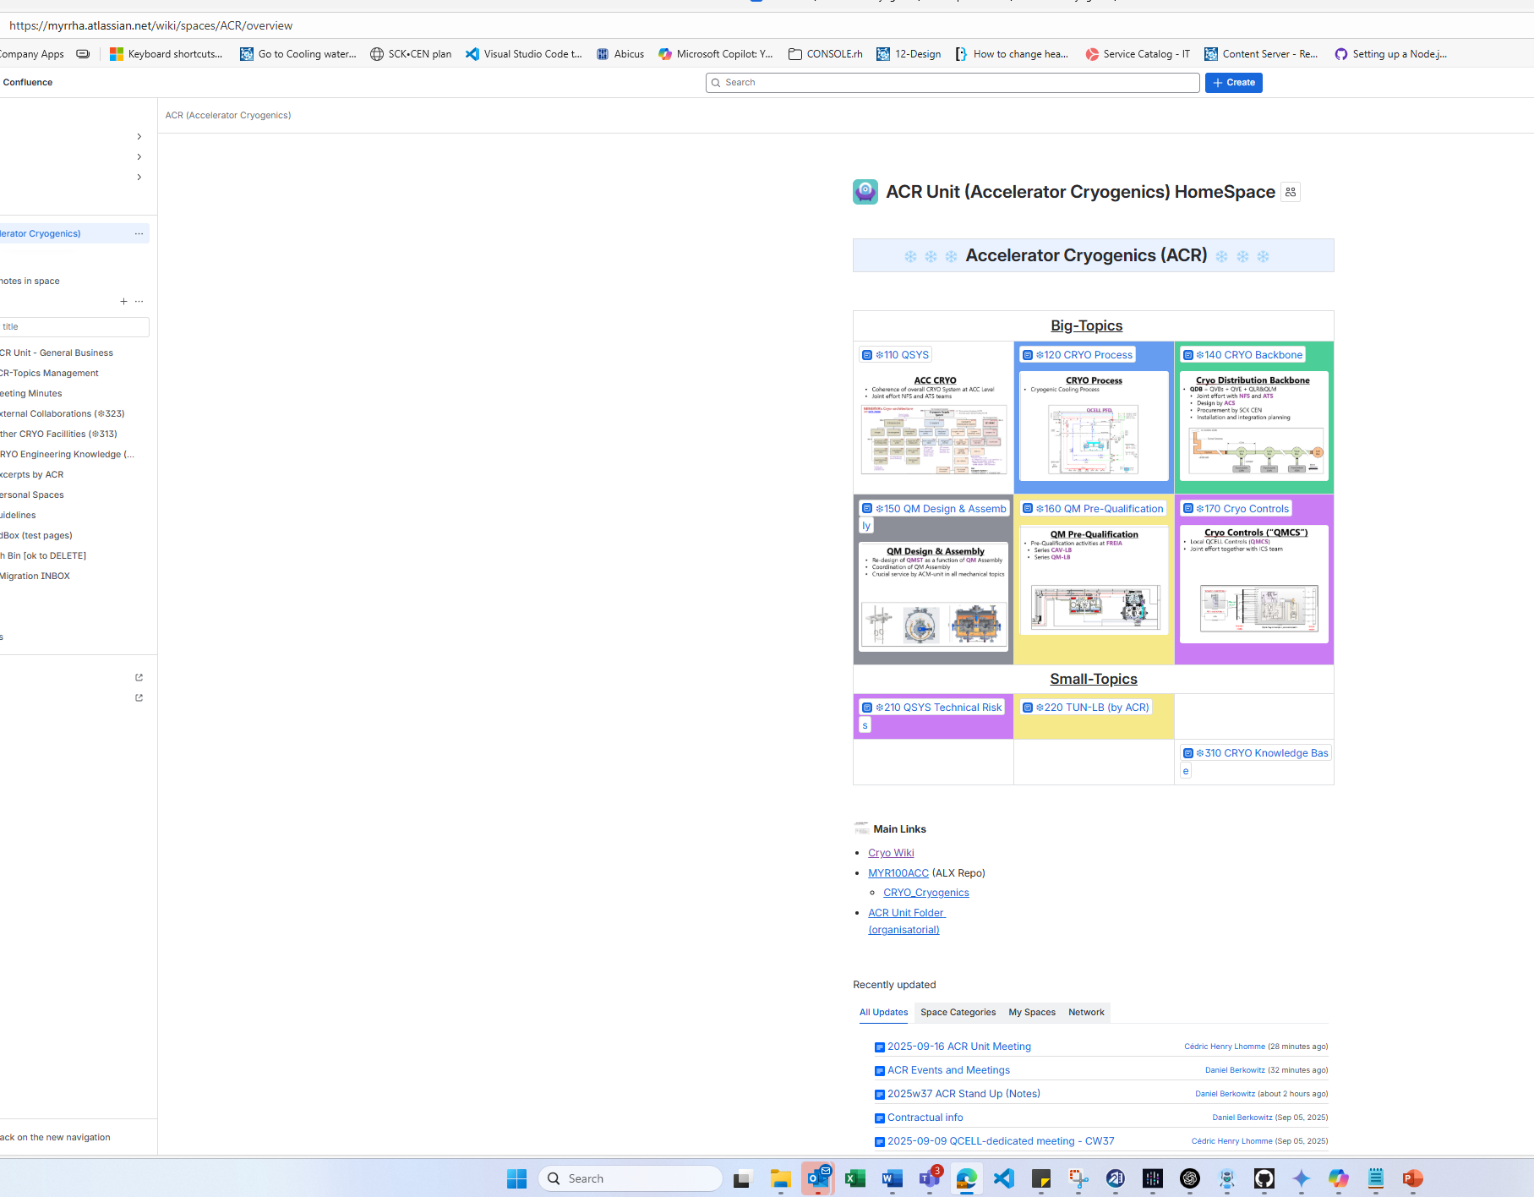

Slide 28
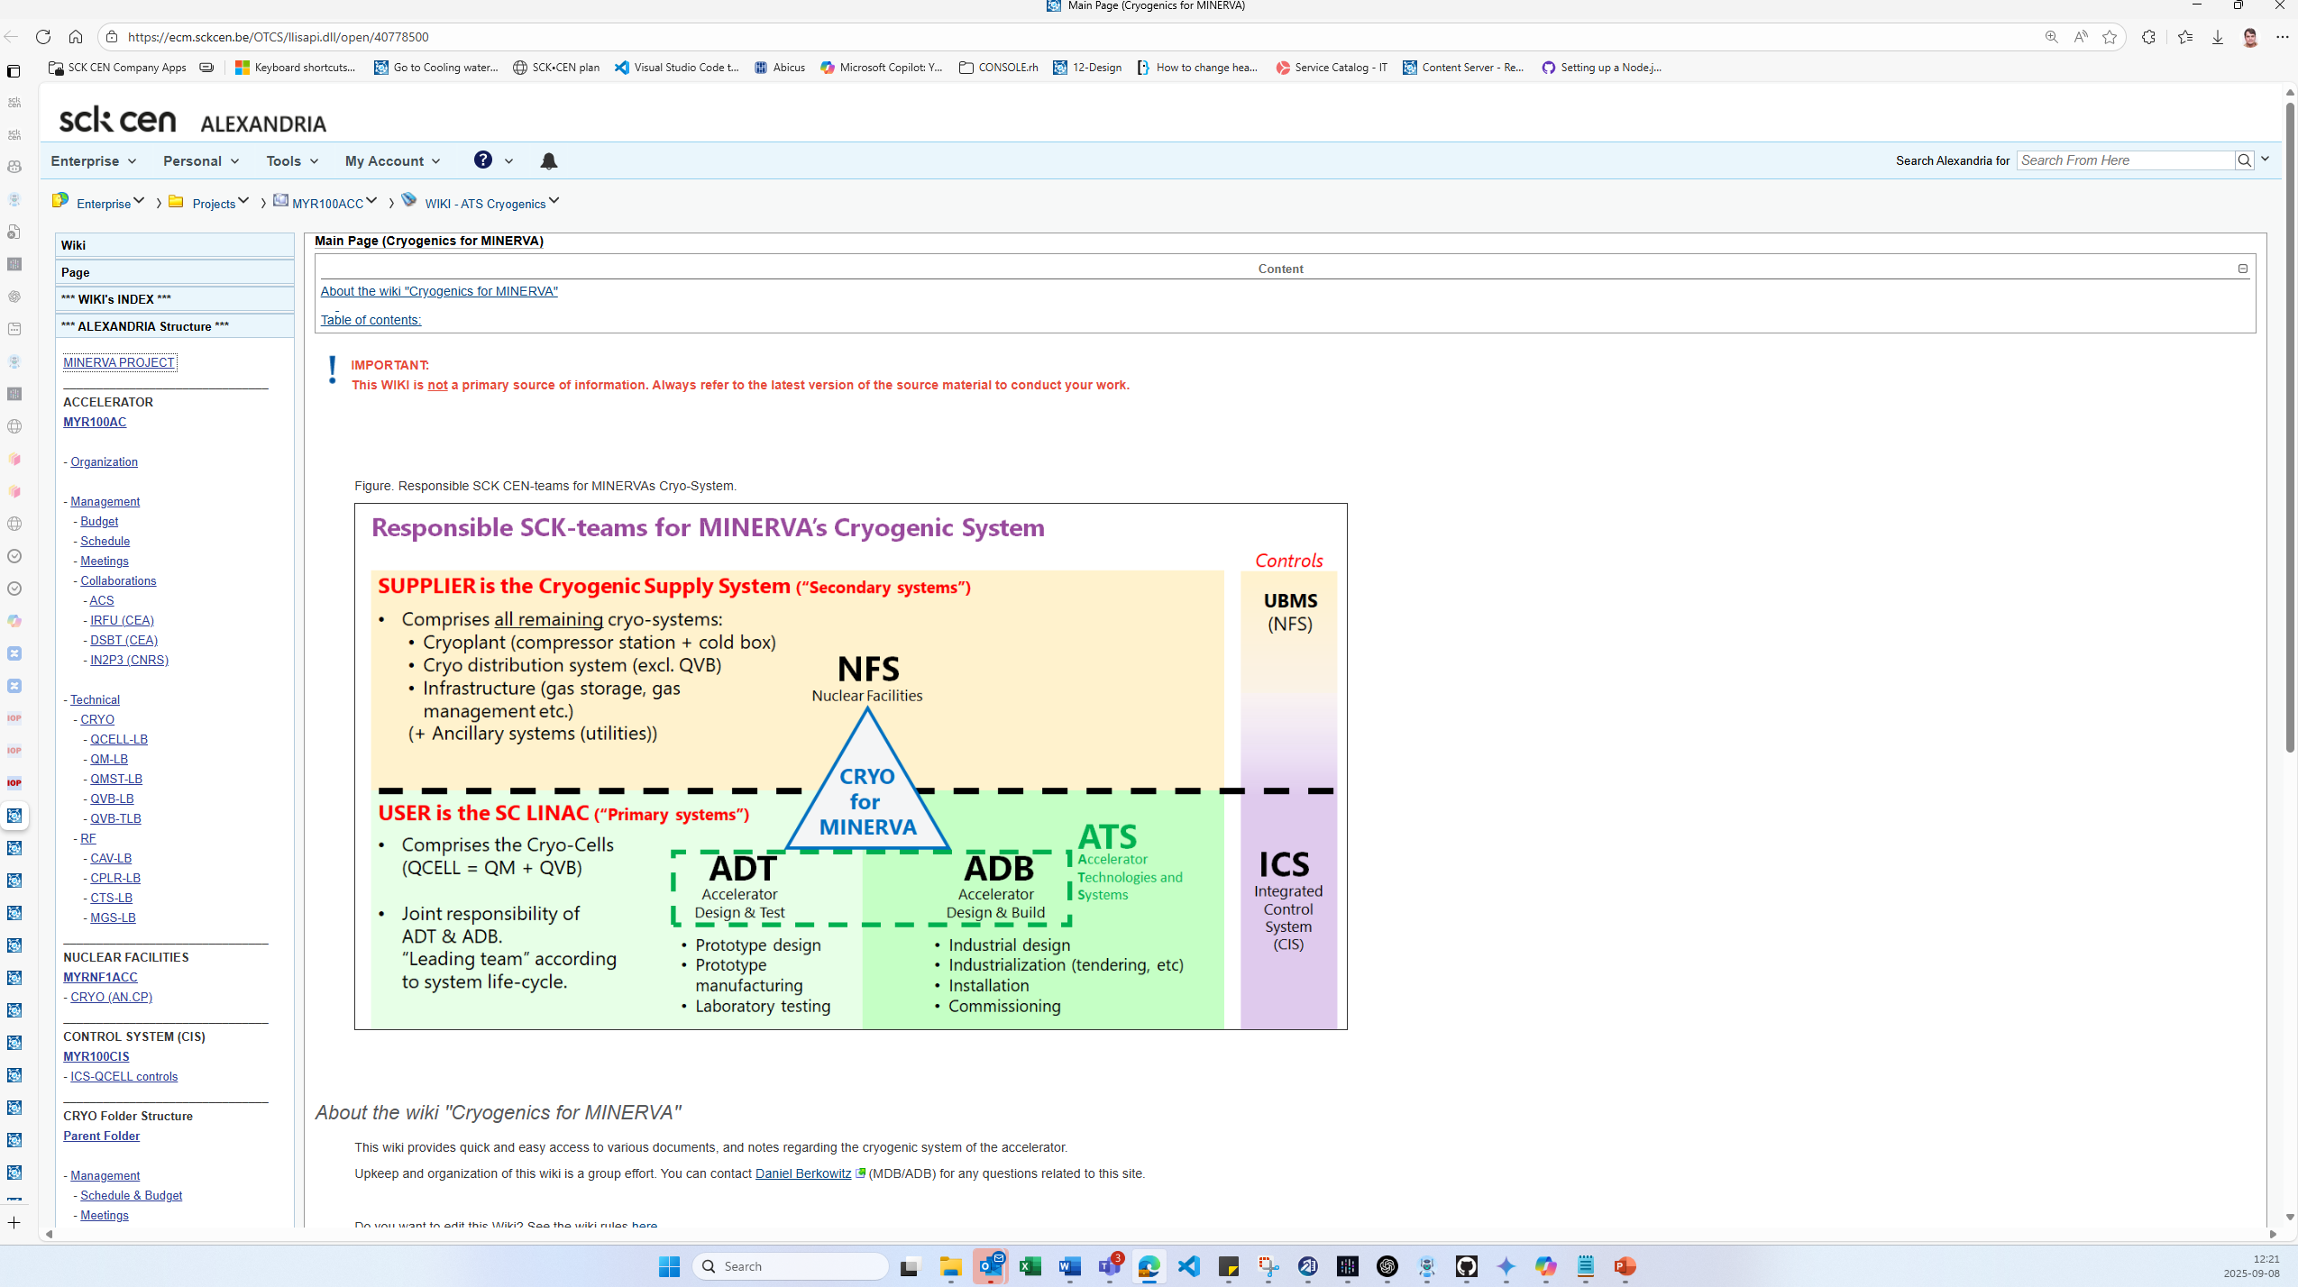

Slide 29
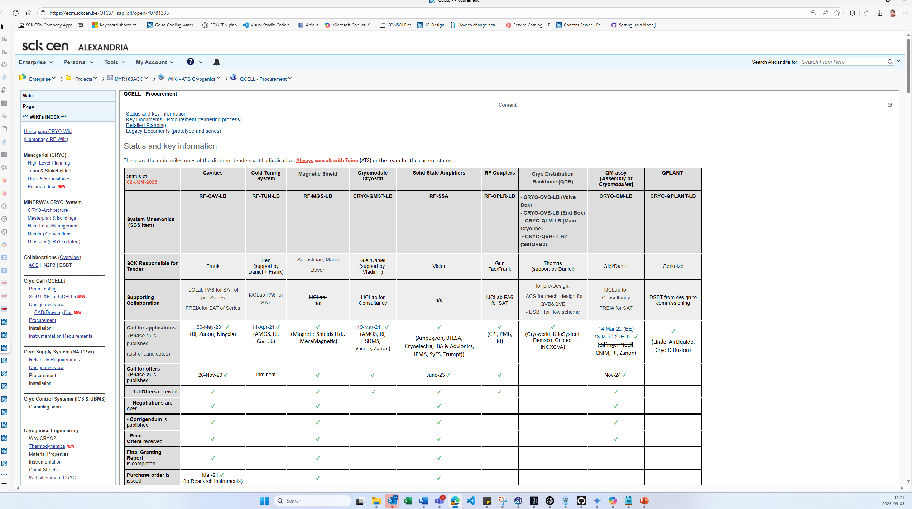

Slide 30
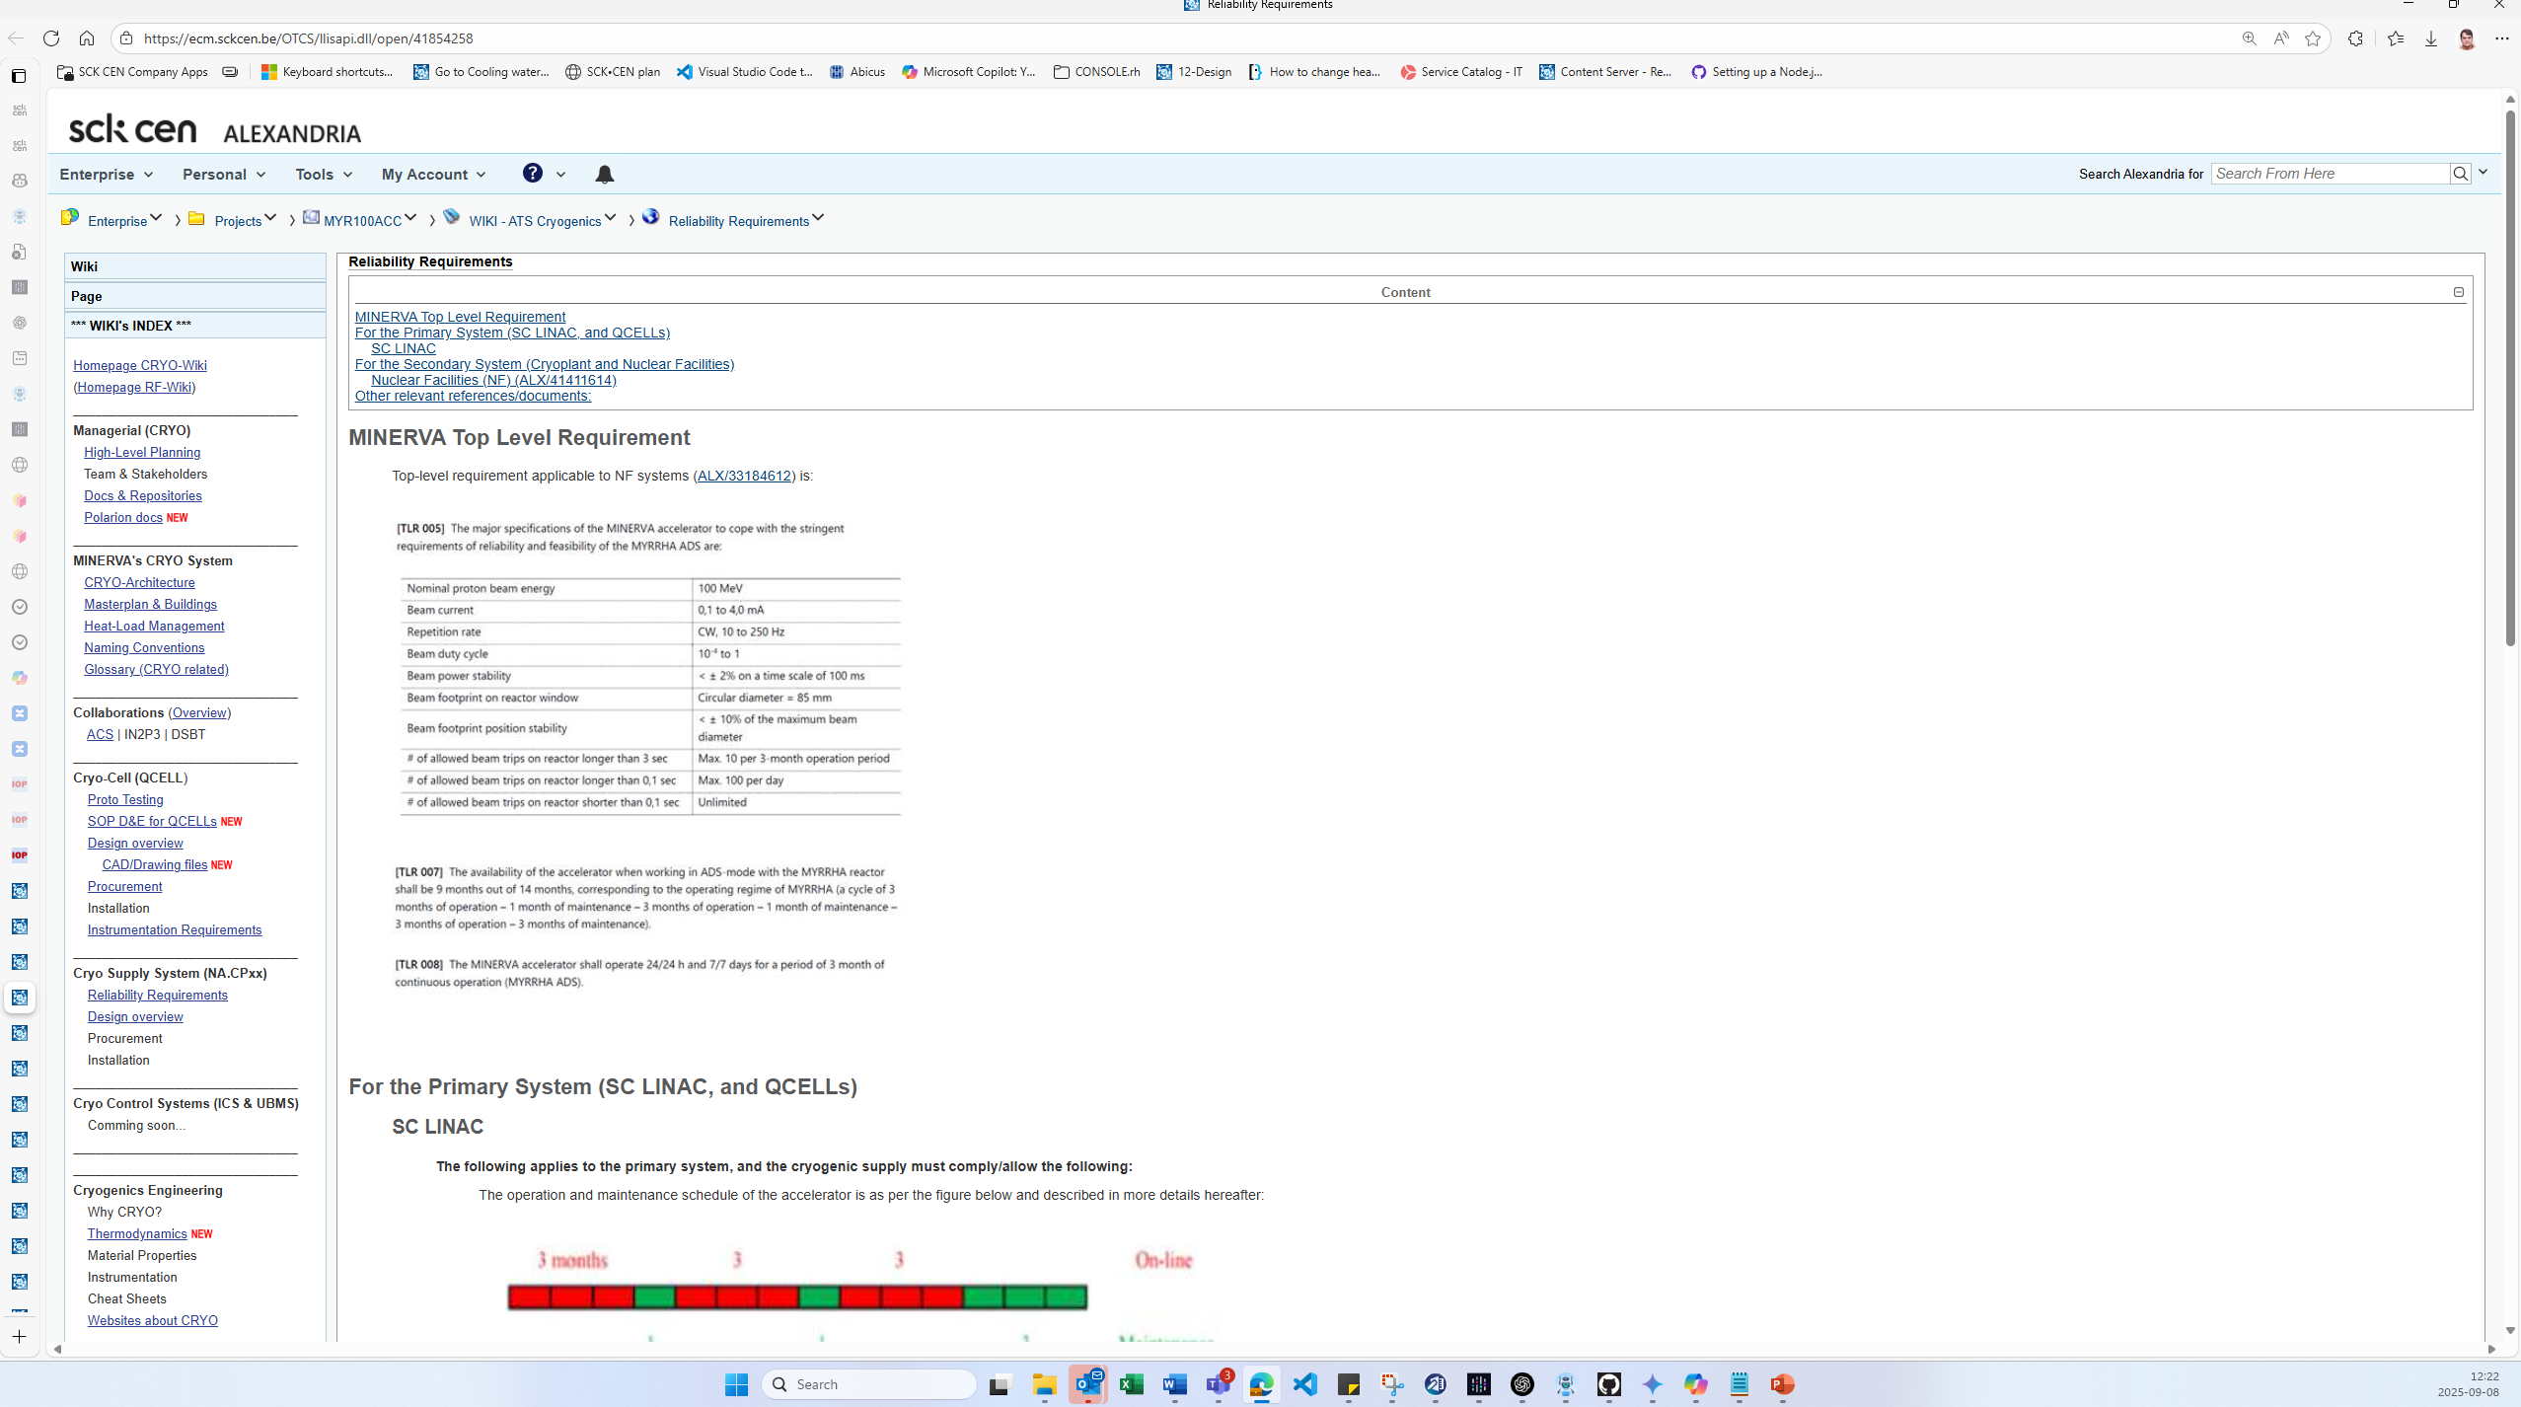

Slide 31
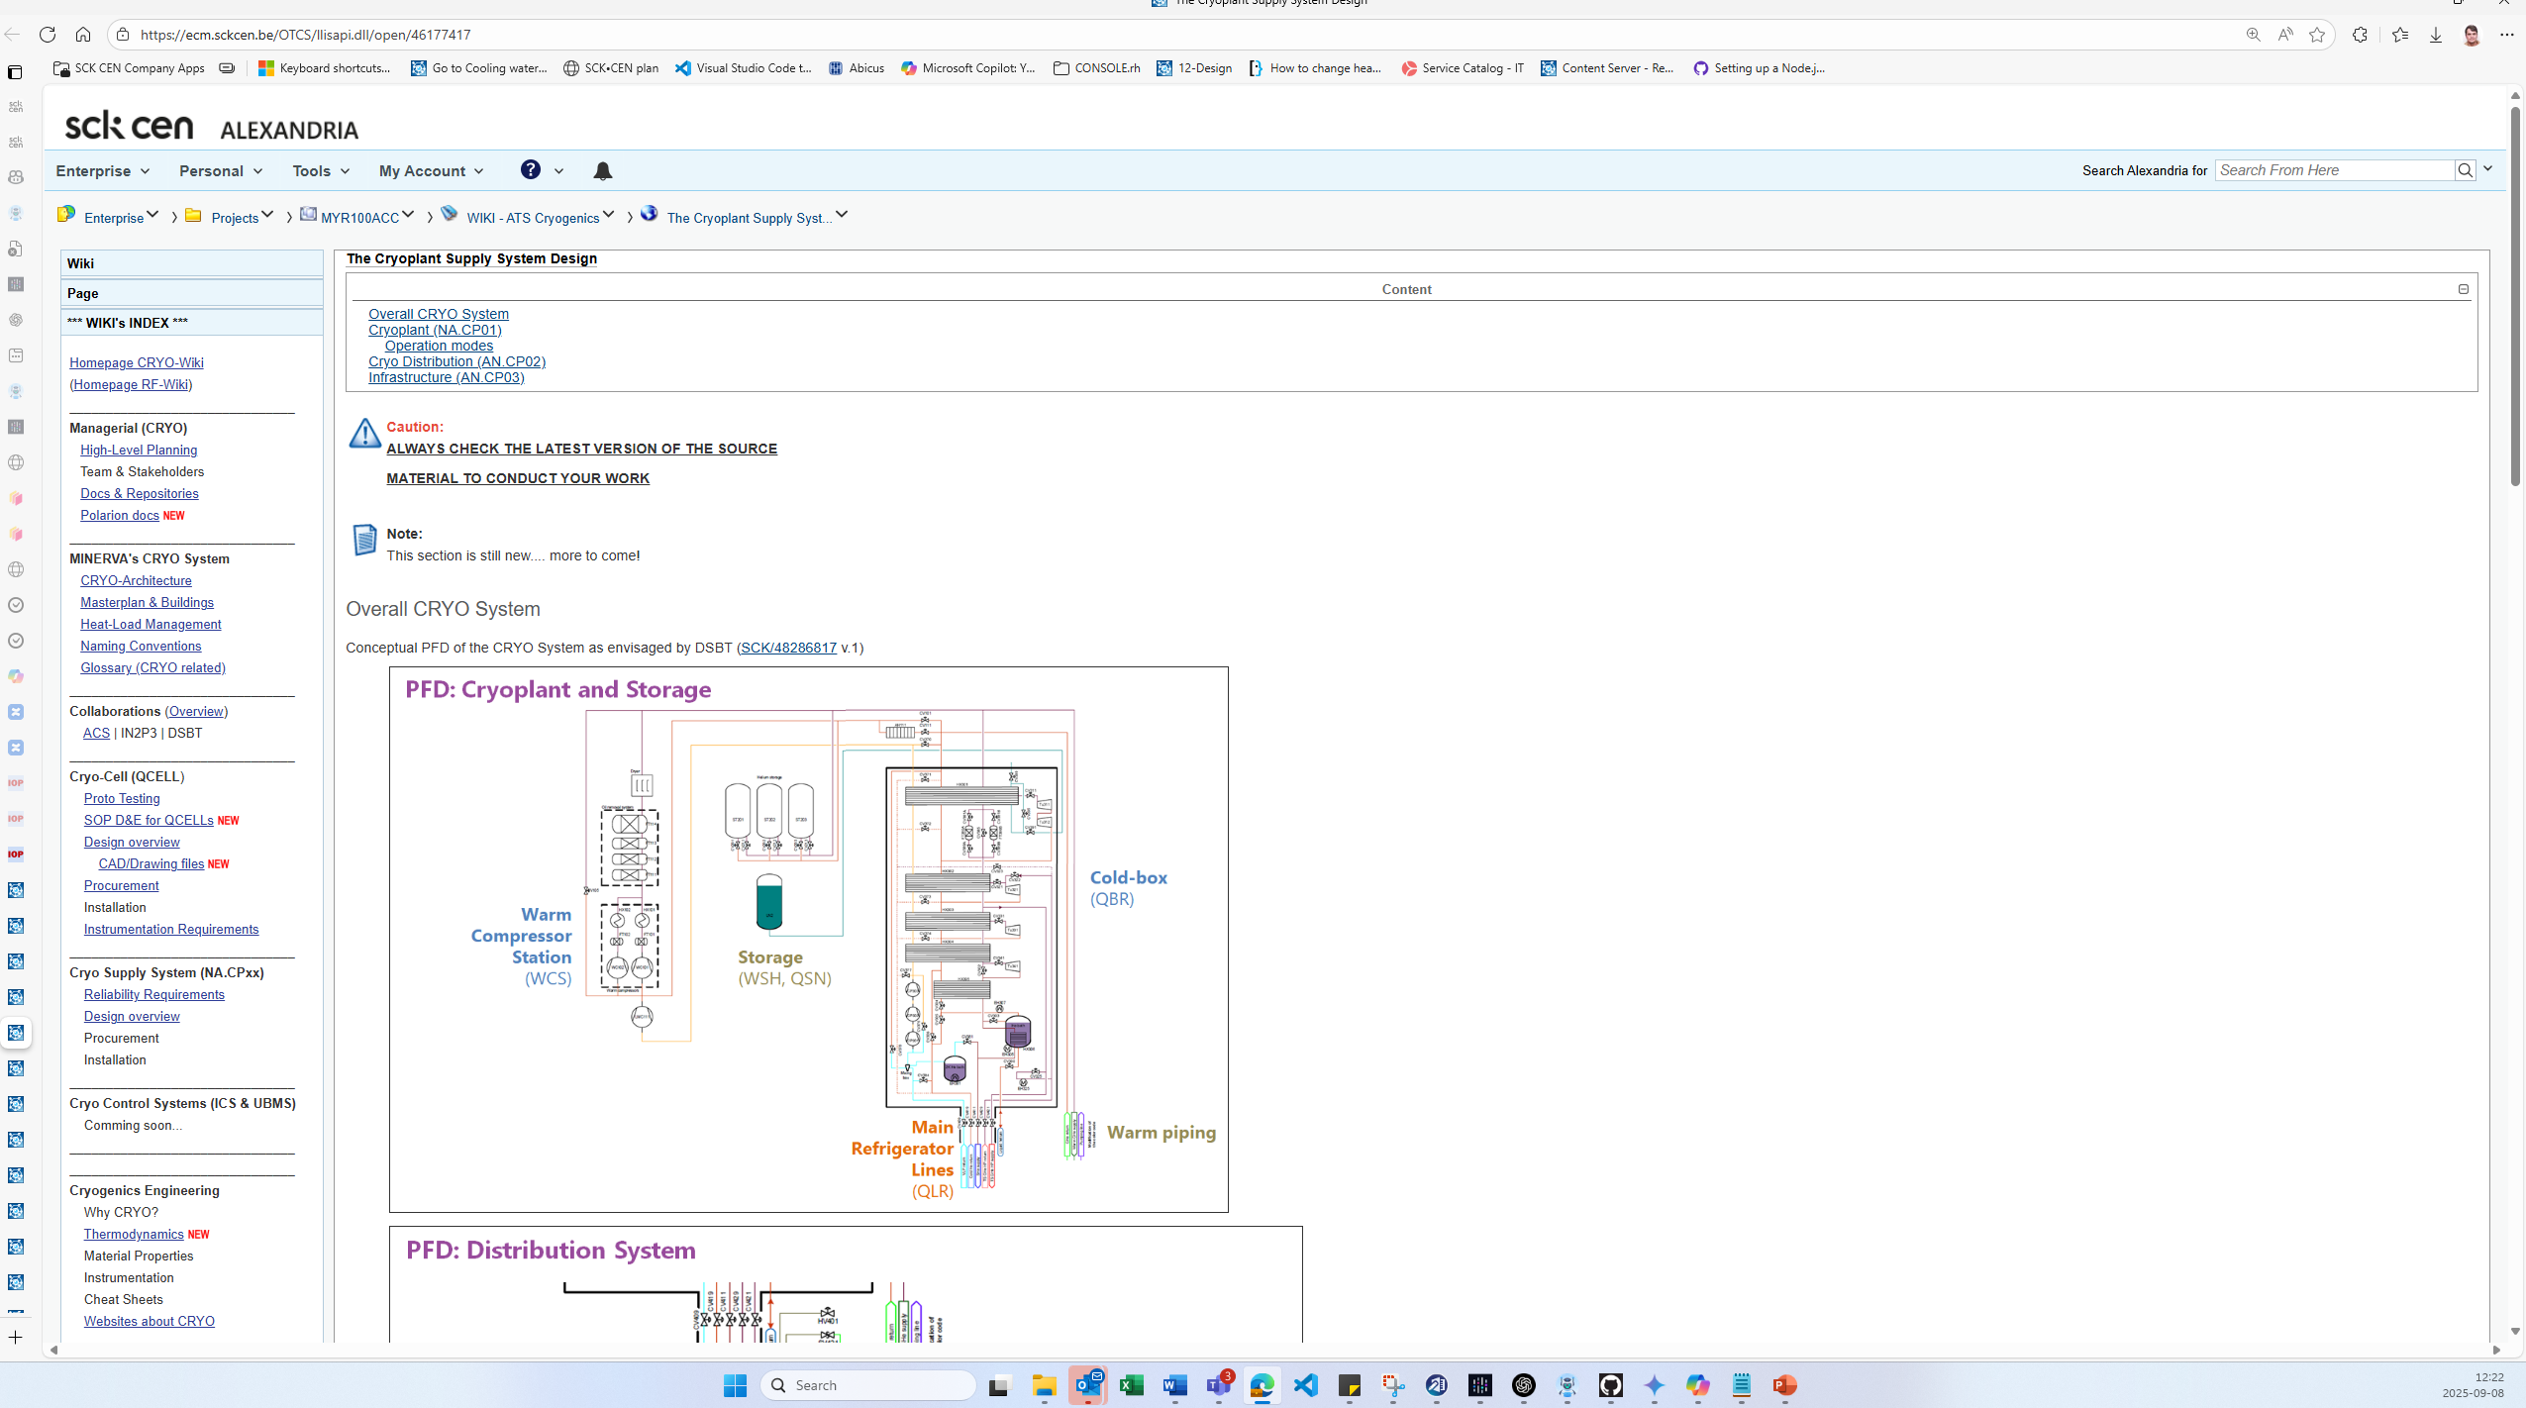

Slide 32
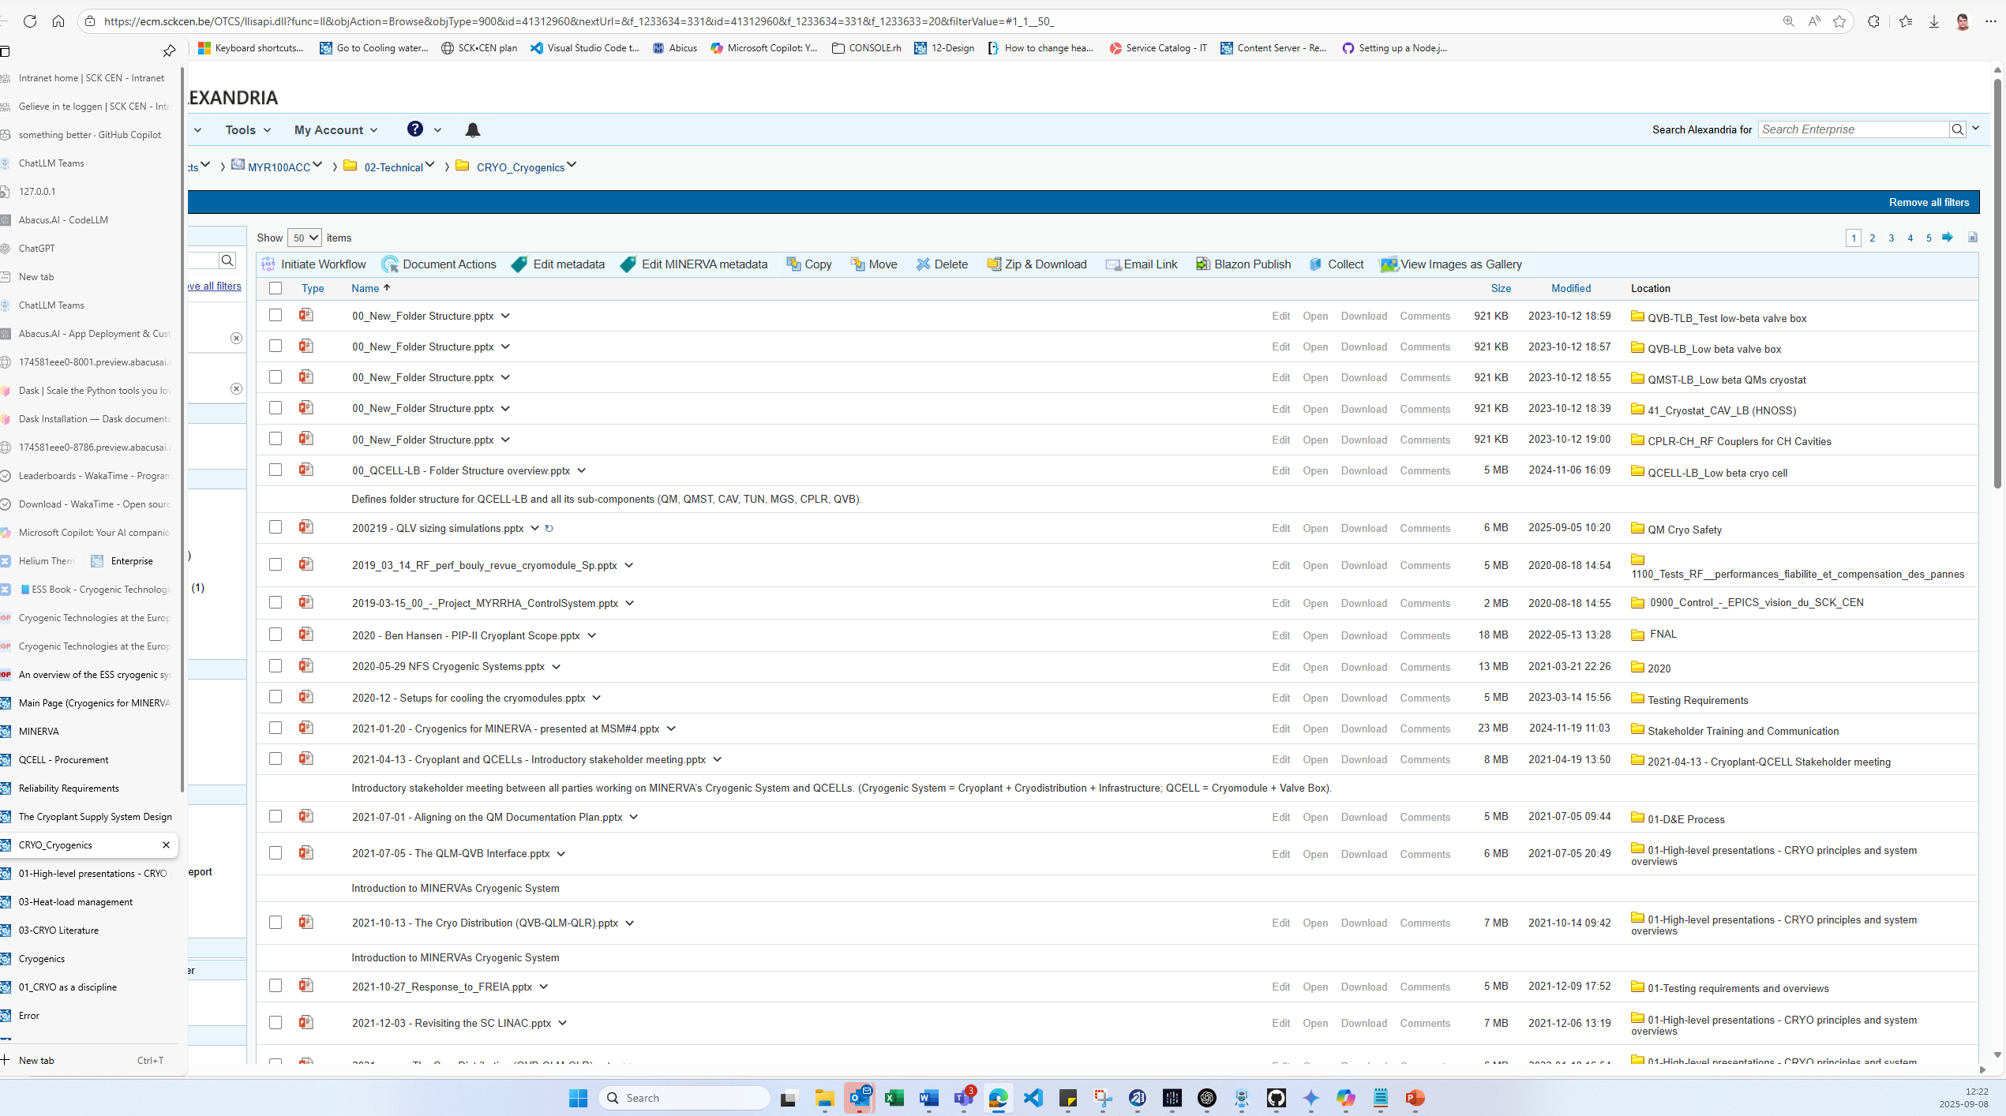

Slide 33
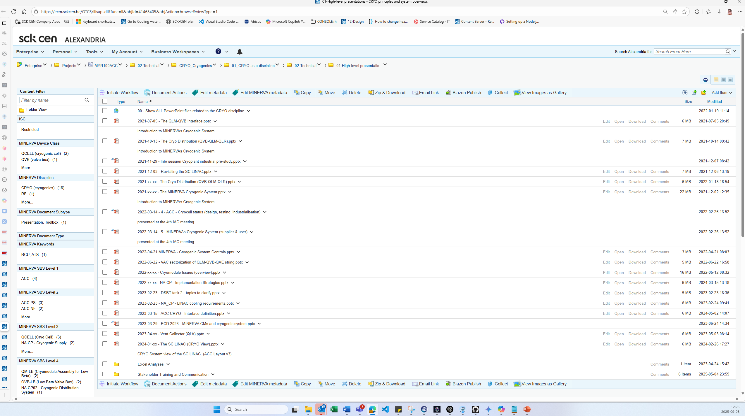

Slide 34
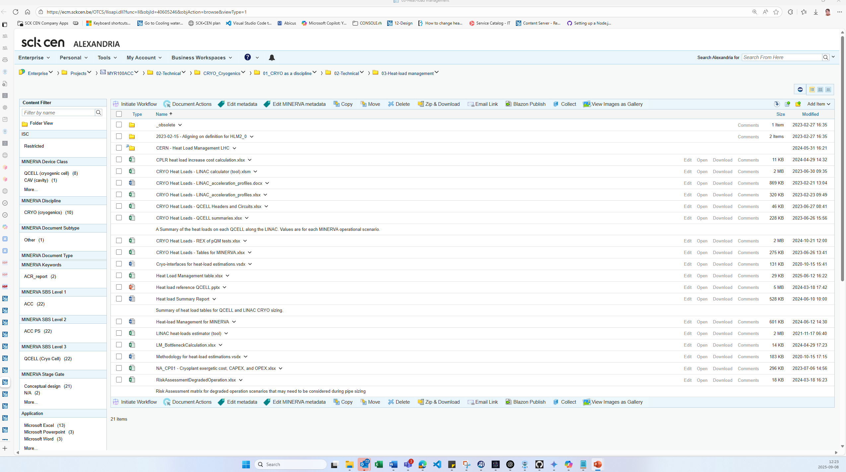

Slide 35
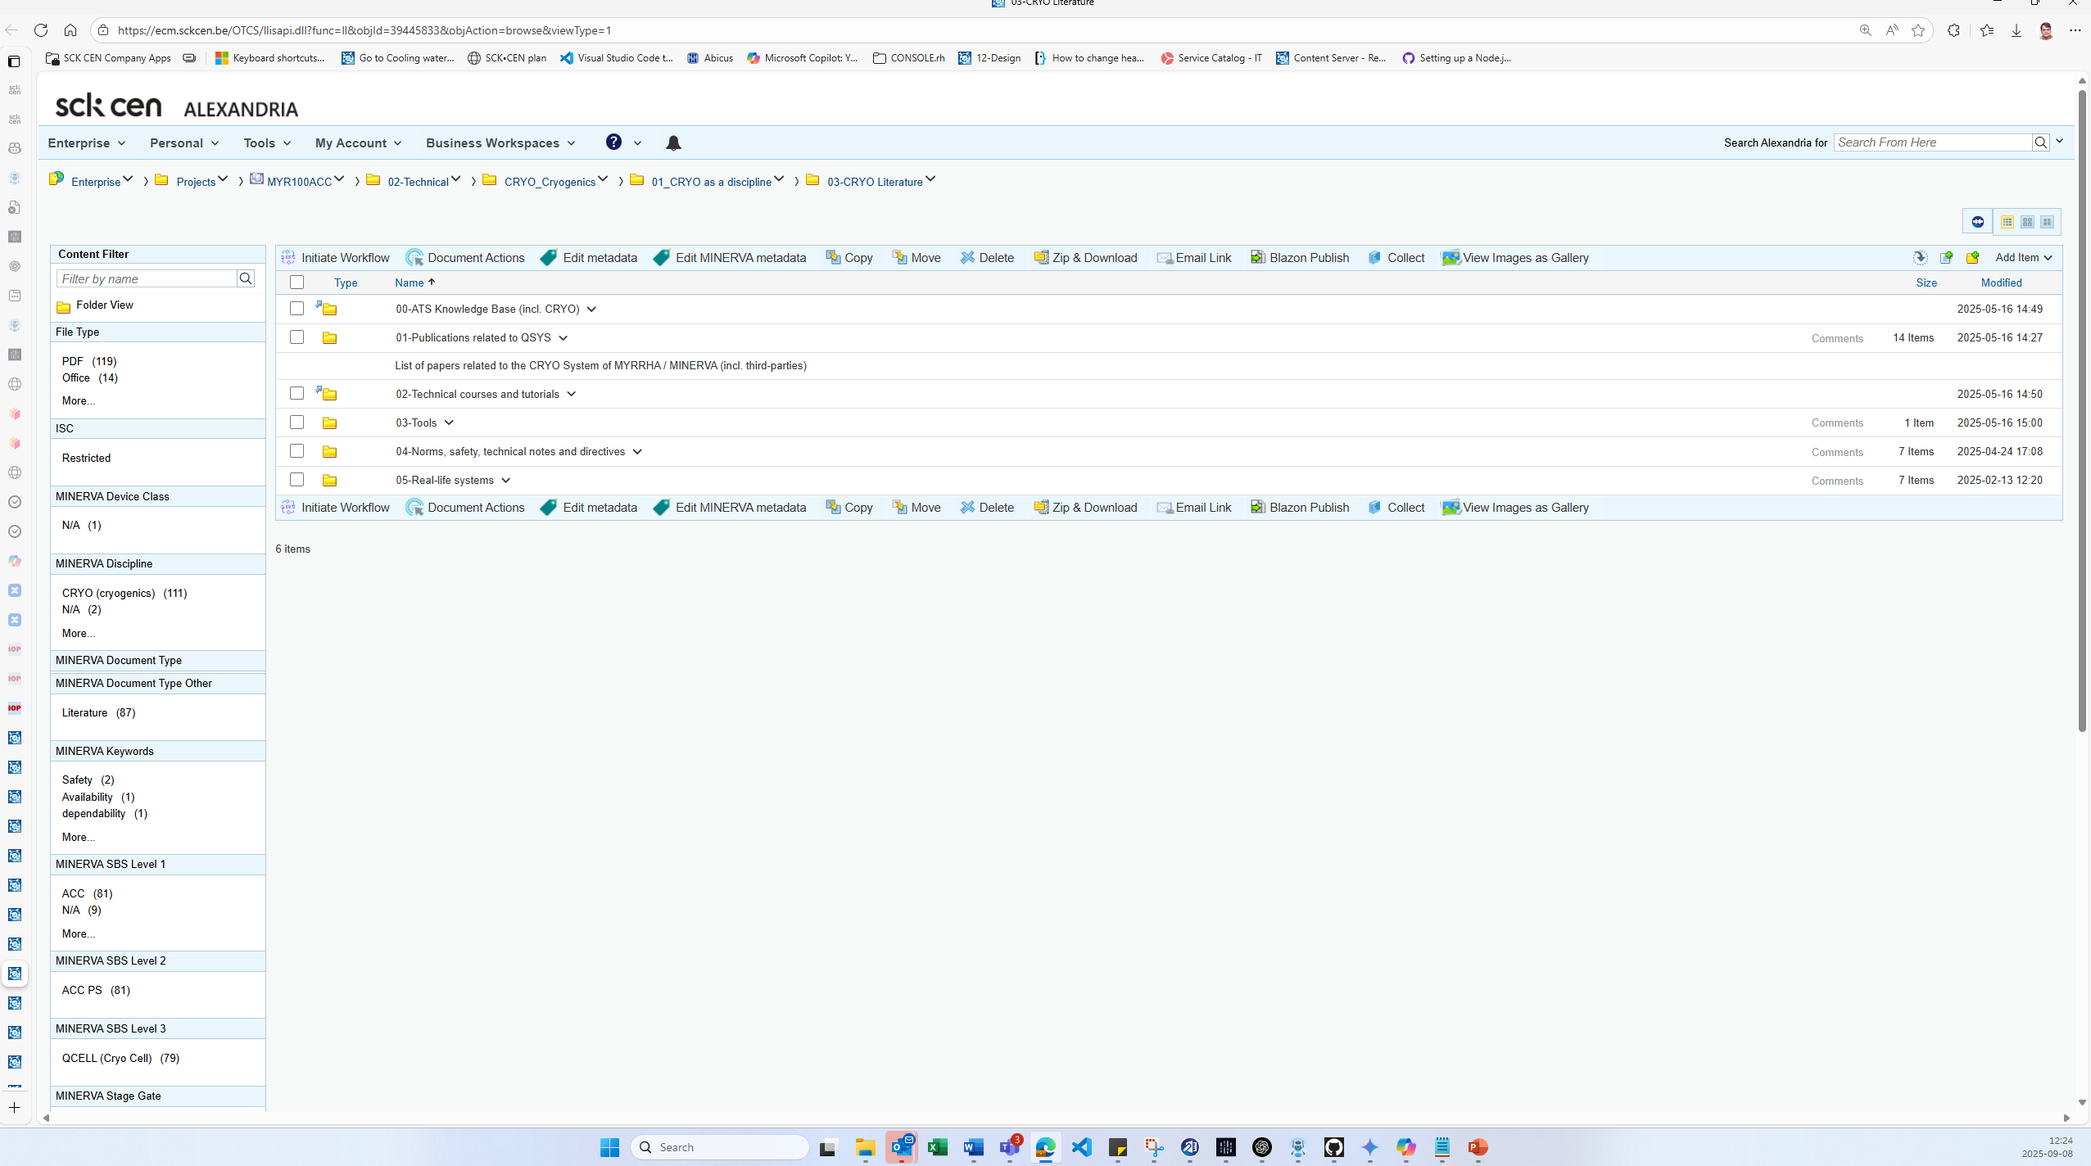

Slide 36
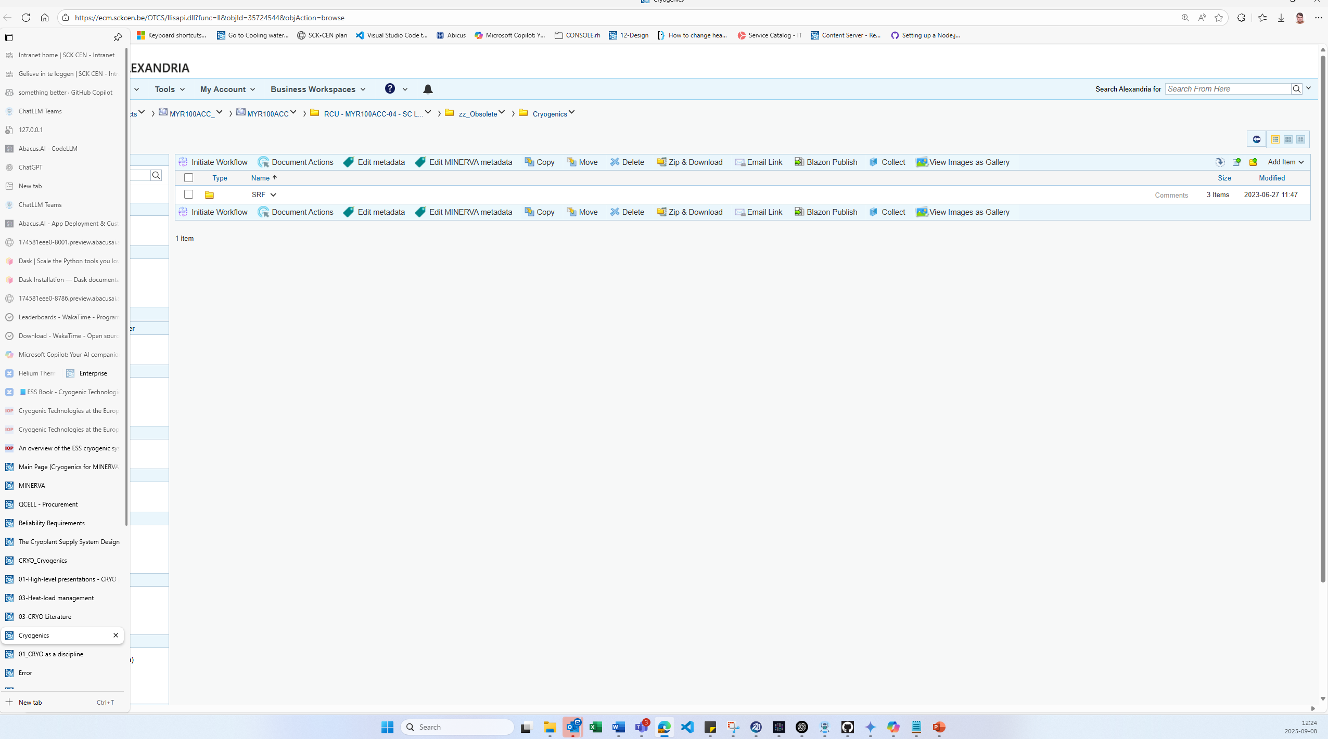

Slide 37
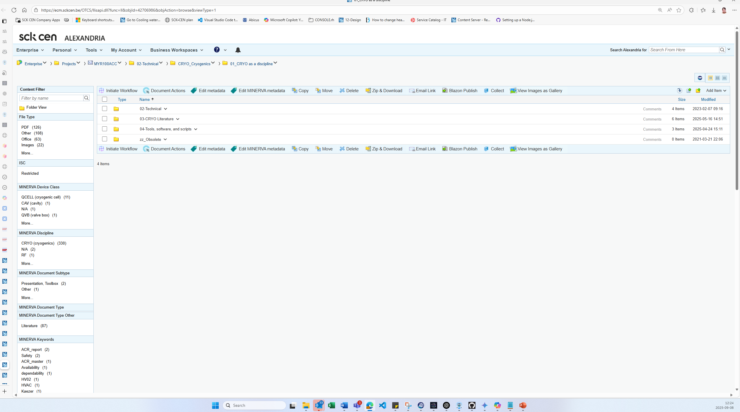

Slide 38
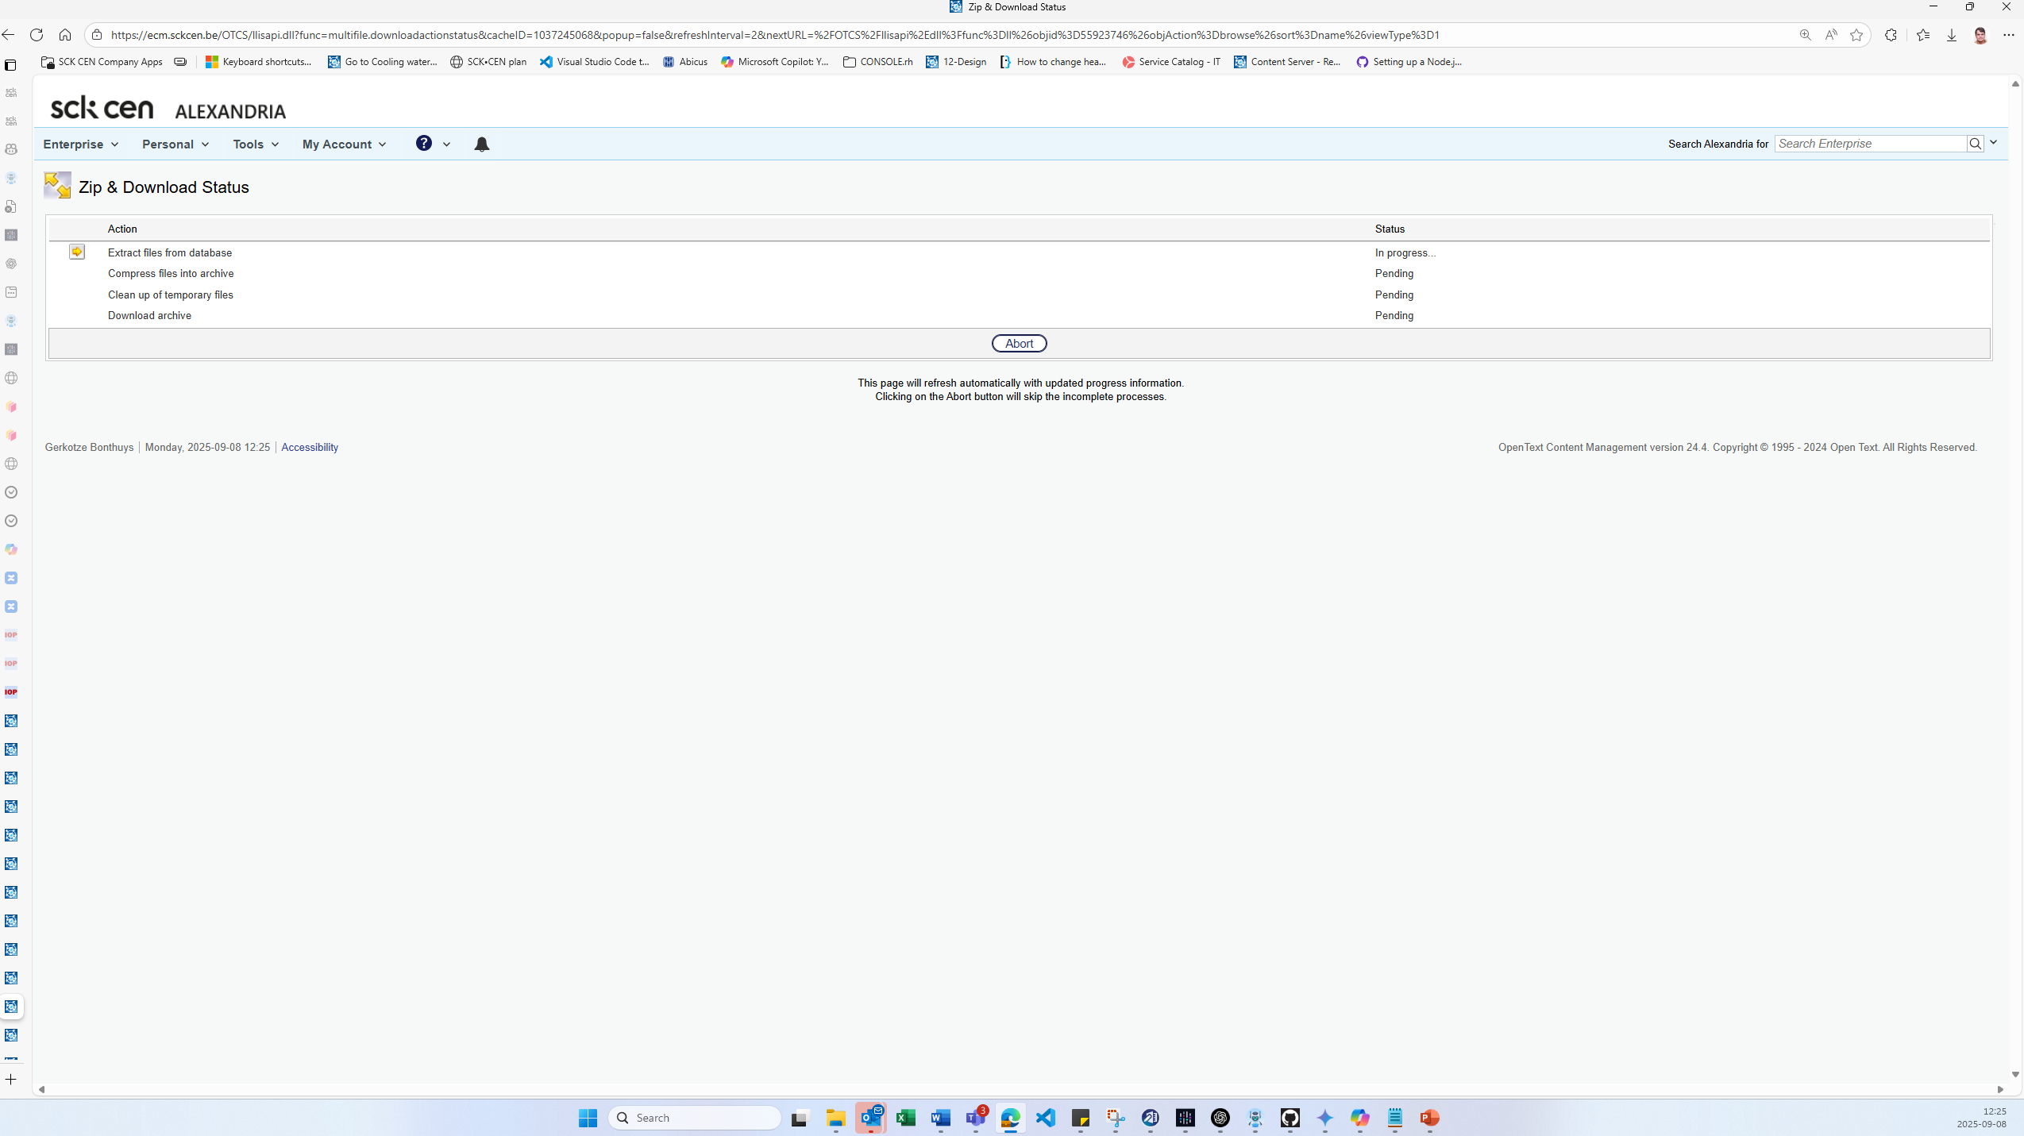
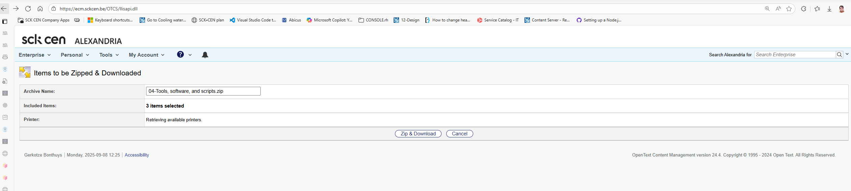

Slide 39
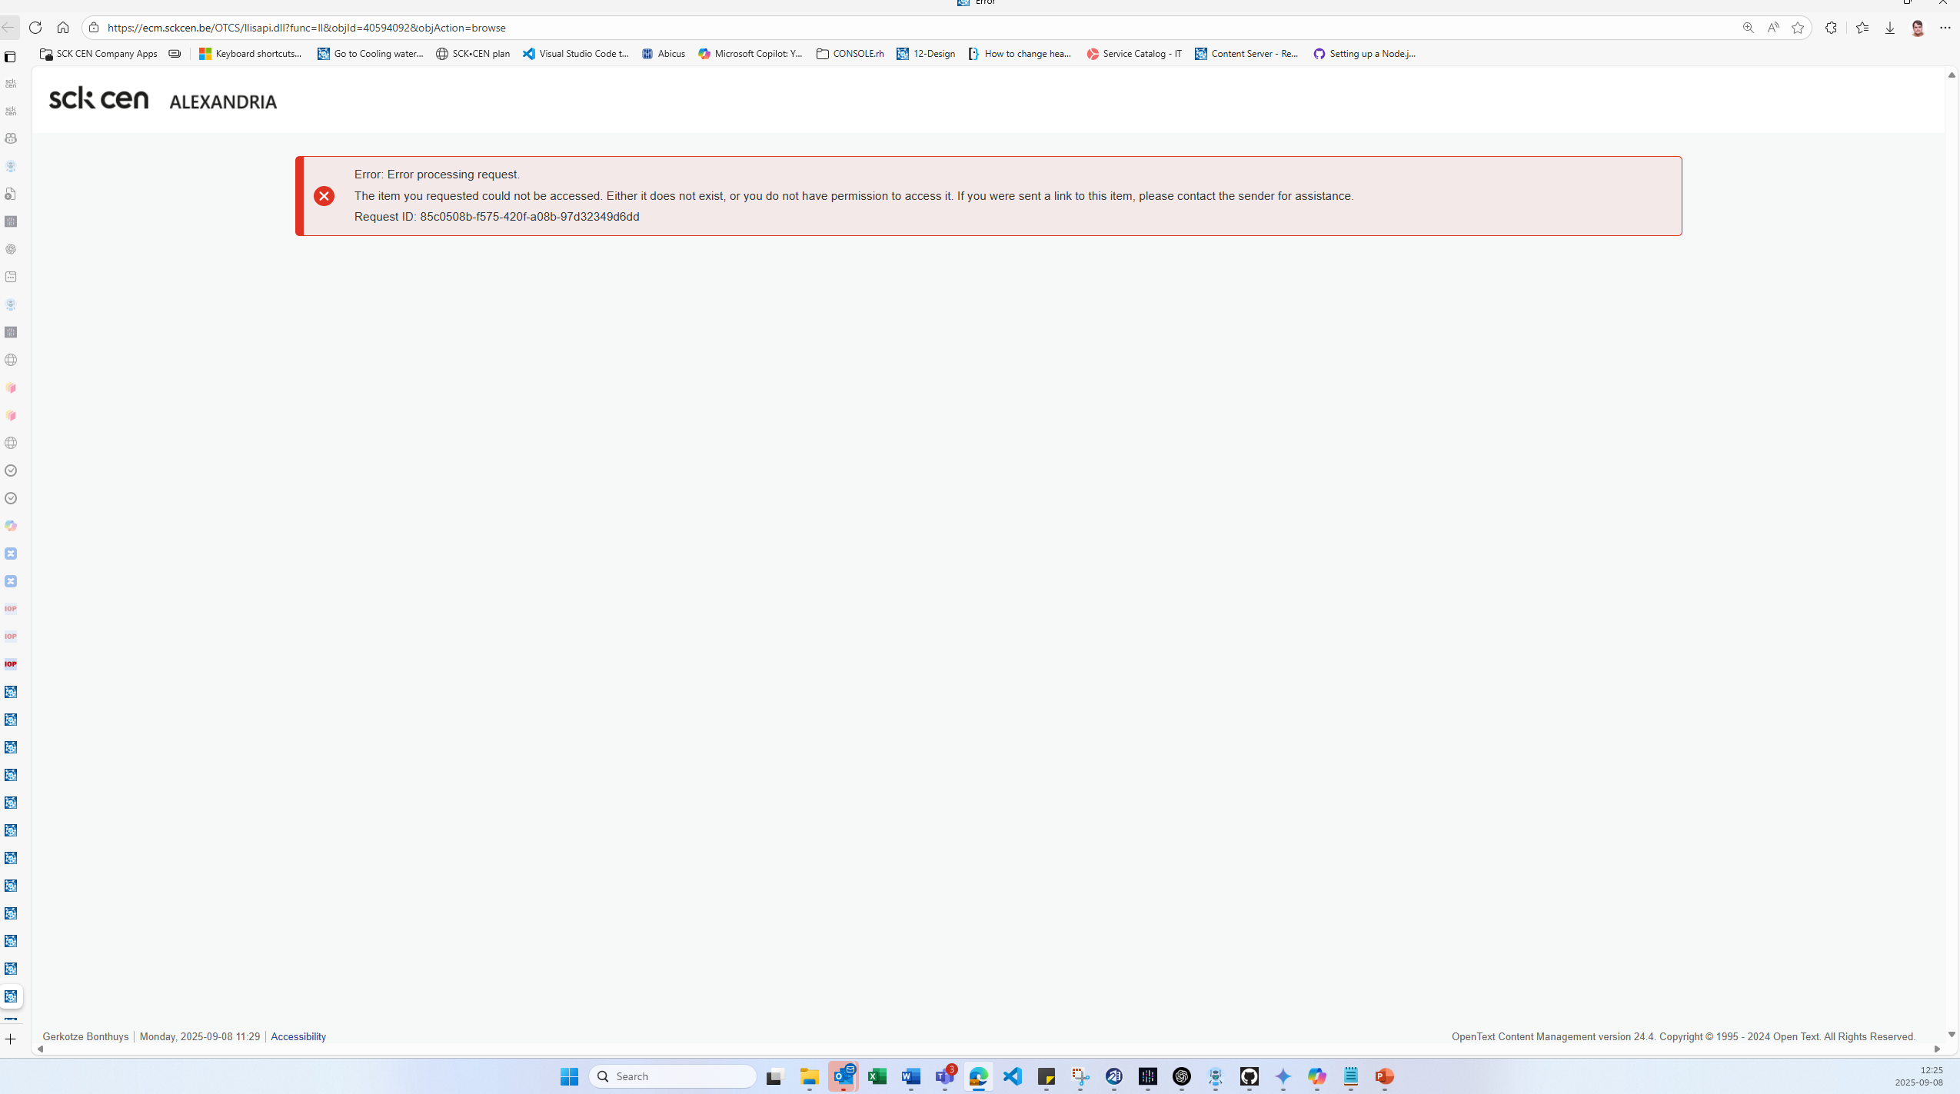
PERMISSION denied is OK for ONEDRIVE (root PC and non-ADMIN rihts – BUT keep the ‘SCK CEK/#####’ ,number (this is the reference and with acces number (as I as isuser have I have acdse – but this not accessbi form out ibezer oe

Slide 40
PERMISSION denied is OK for ONEDRIVE (root PC and non-ADMIN rihts – BUT keep the ‘SCK CEK/#####’ ,number (this is the reference and with acces number (as I as isuser have I have acdse – but this not accessbi form out ibezer oe

Slide 41
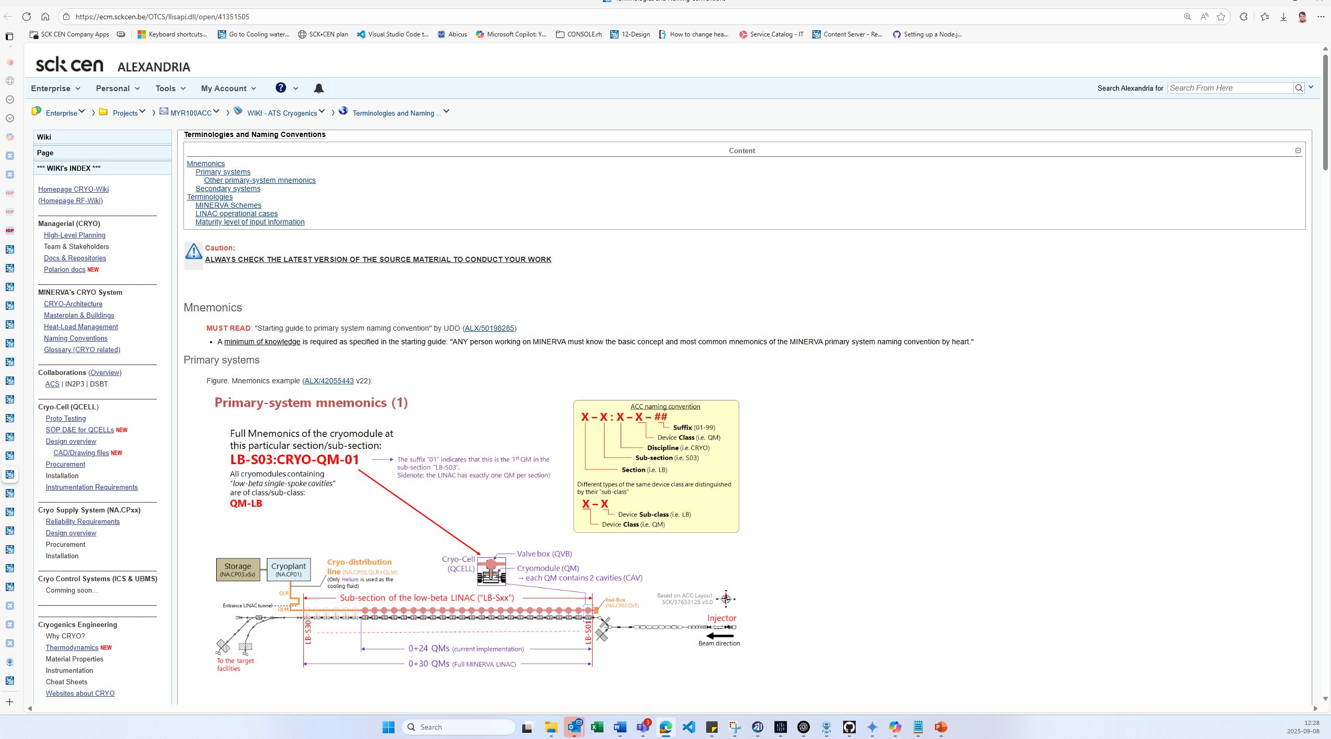

Slide 42
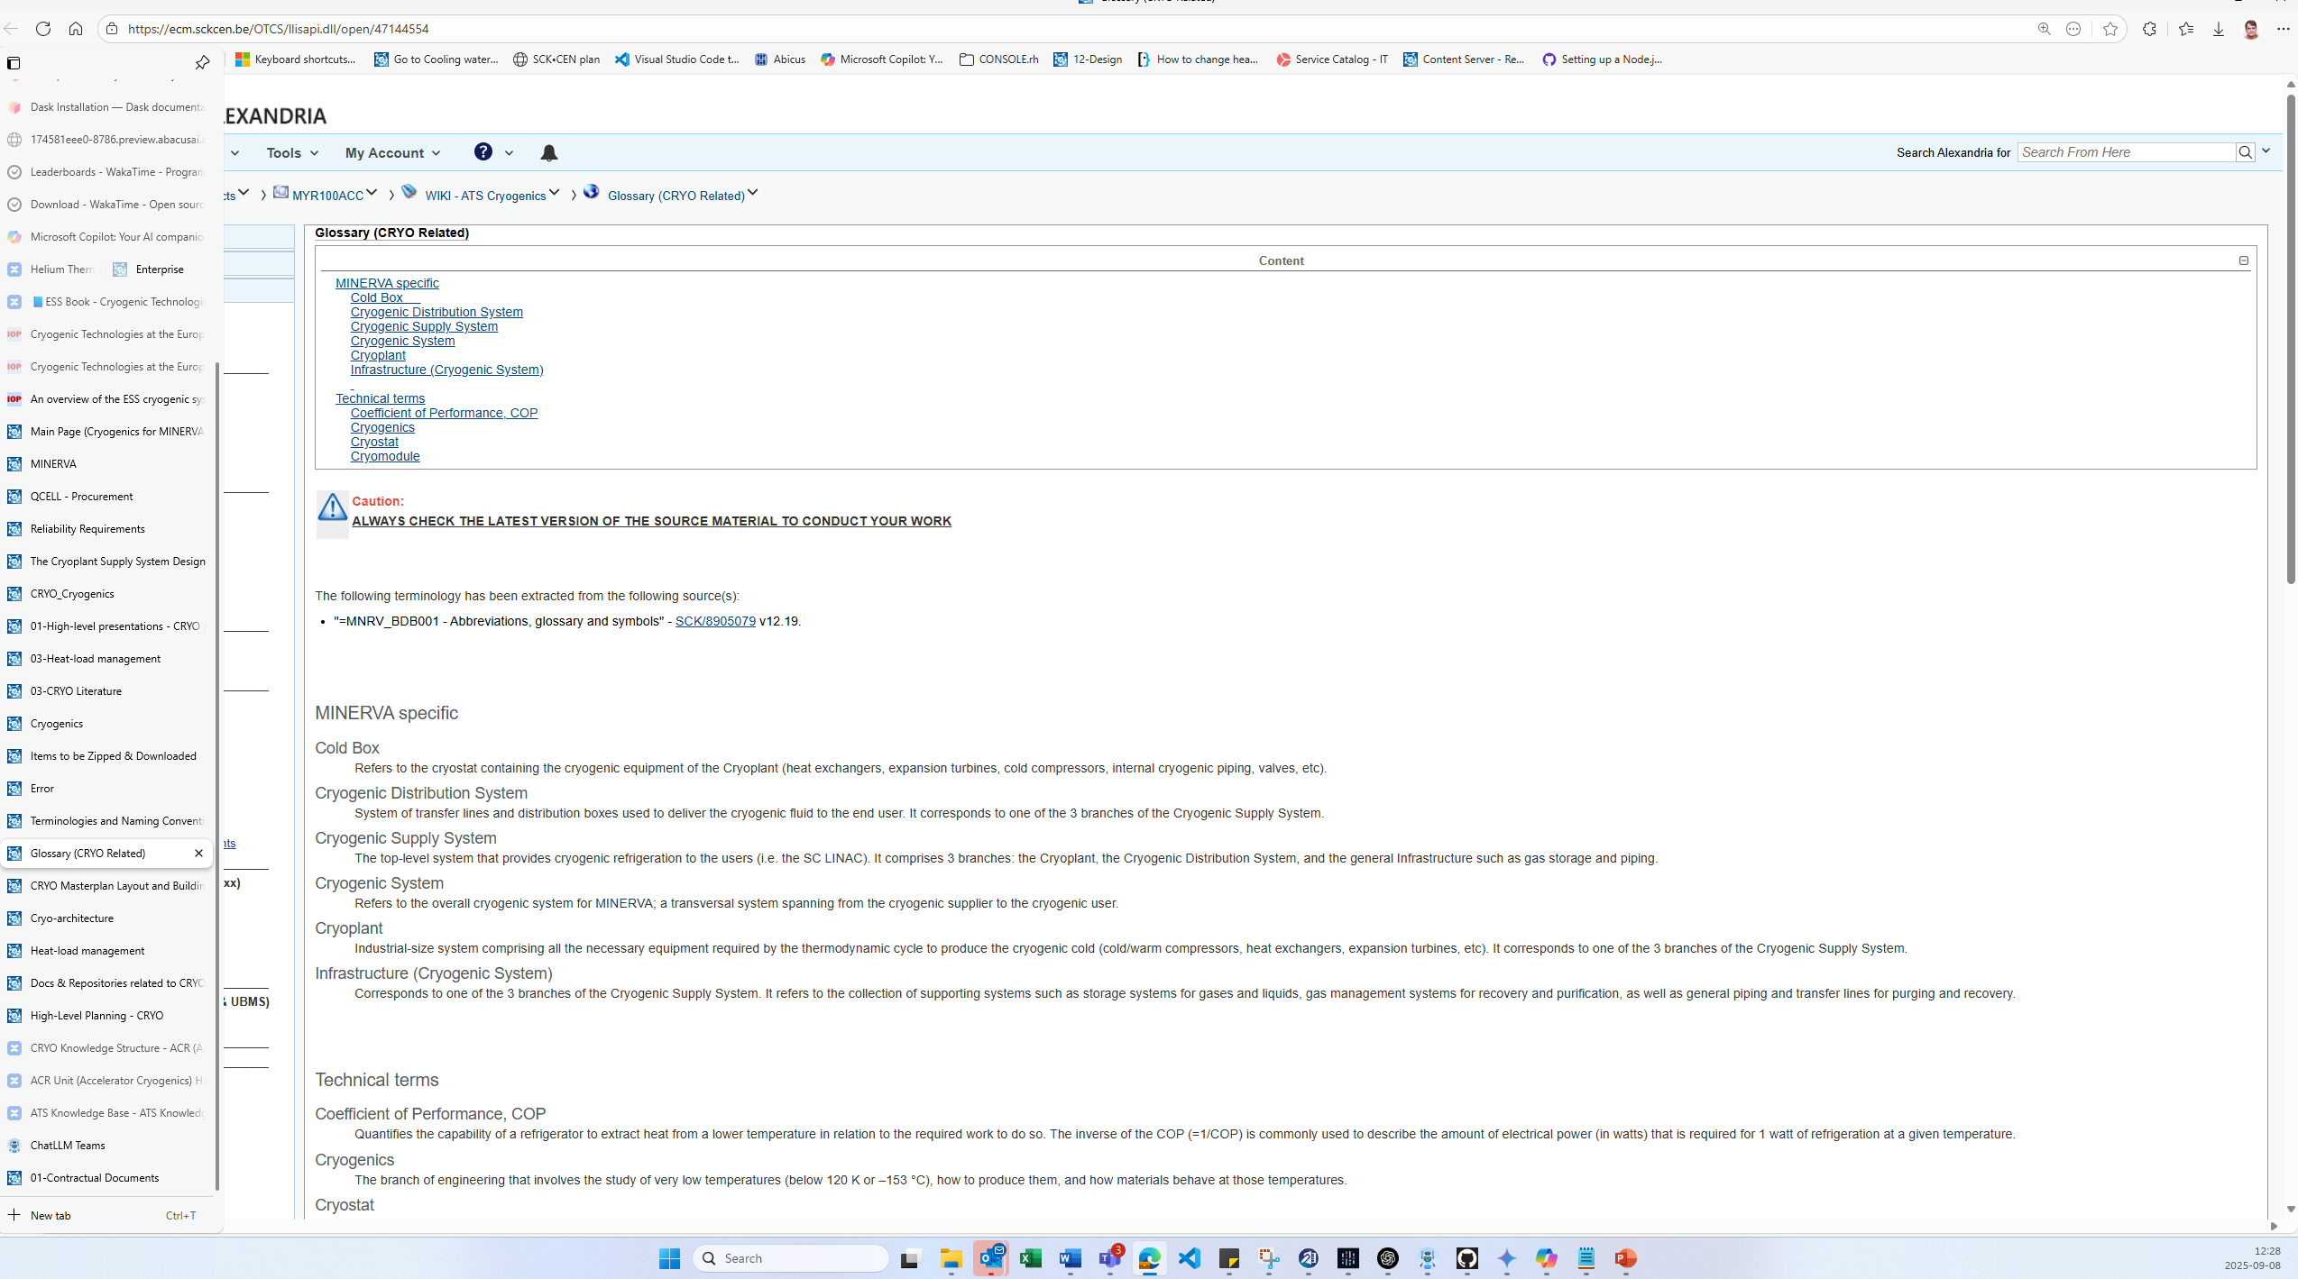

Slide 43
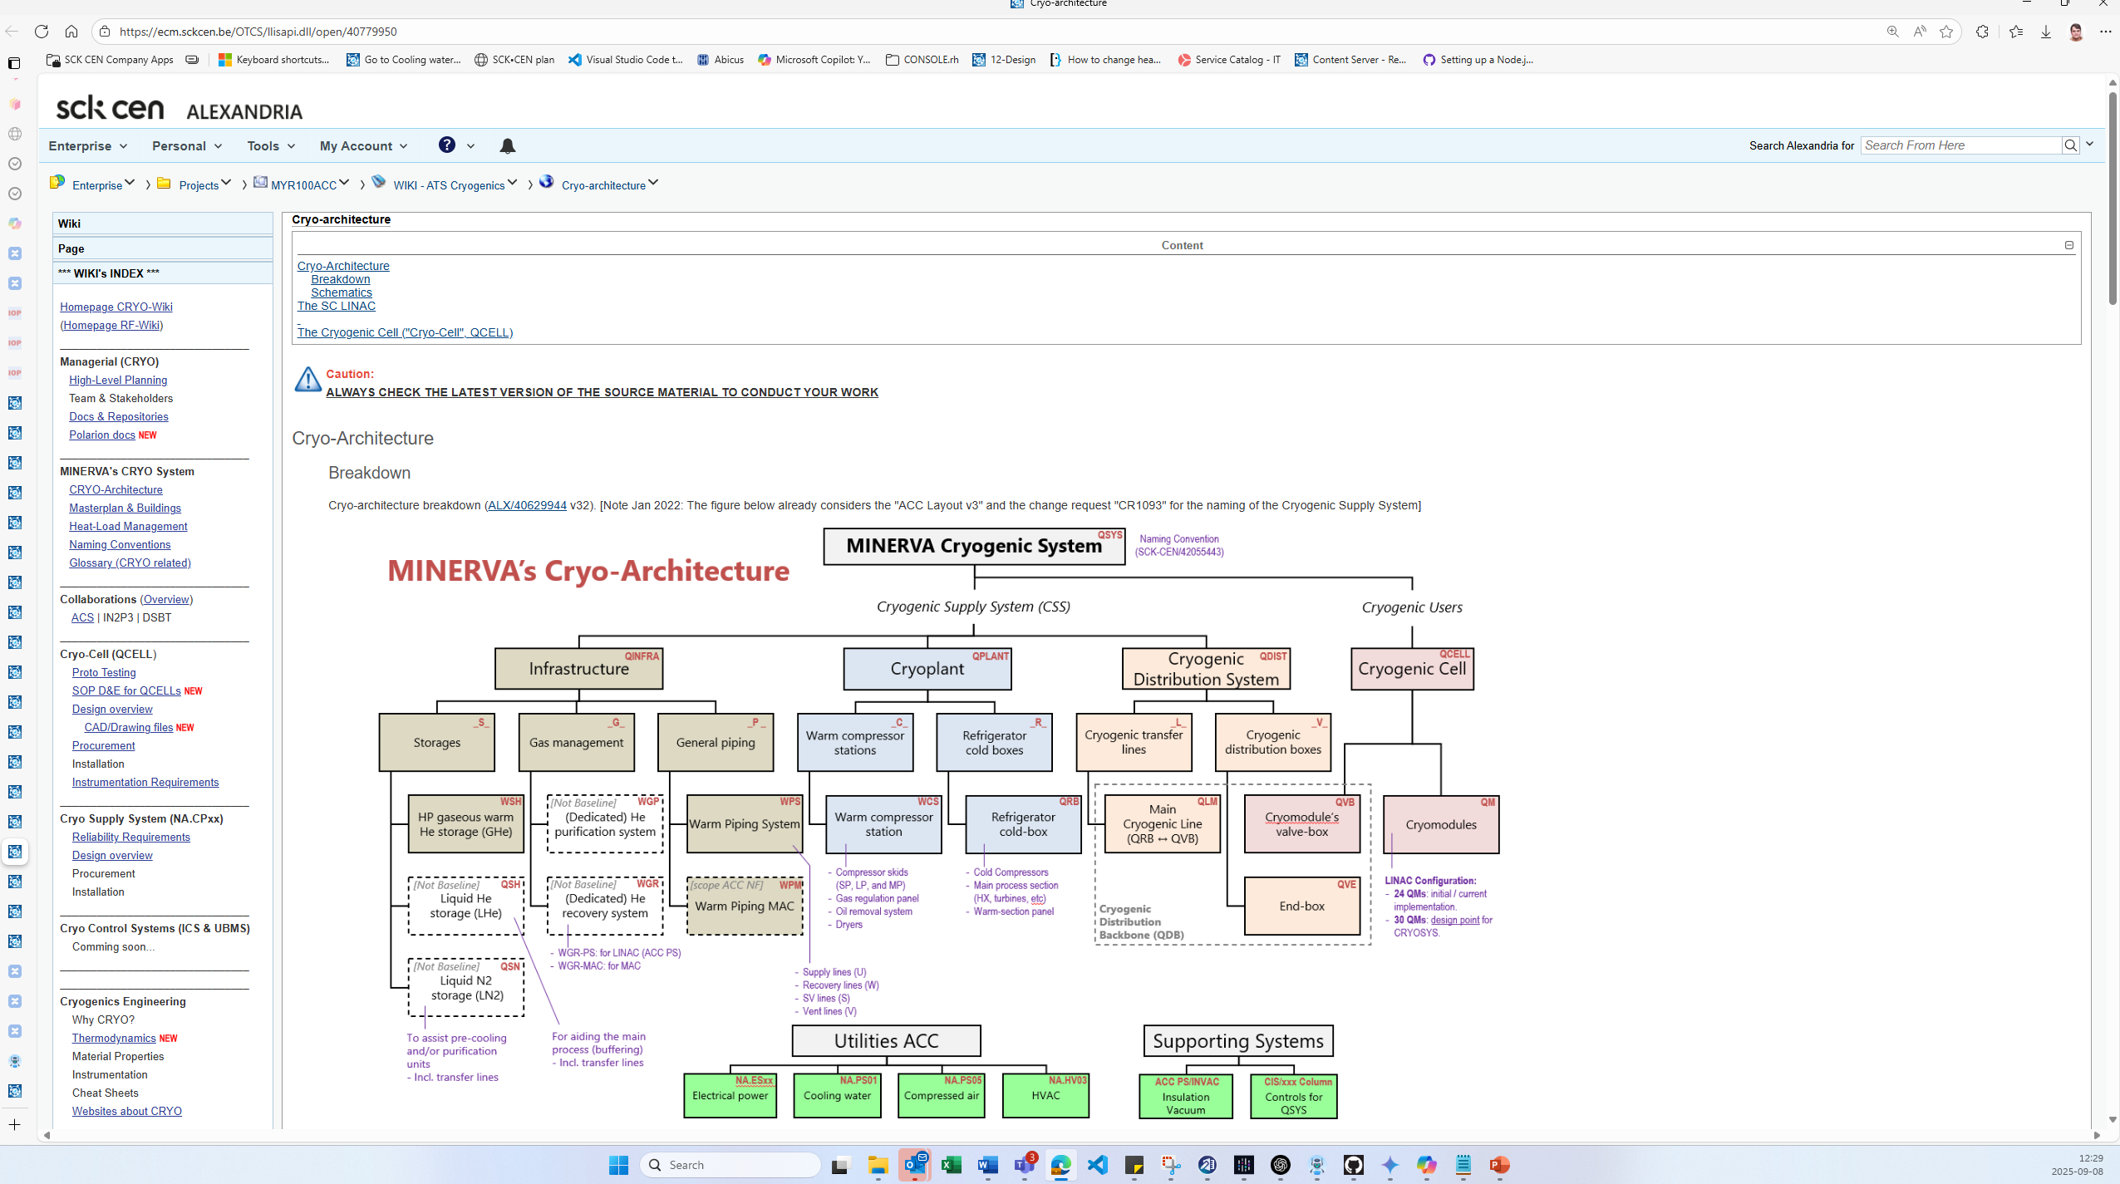

Slide 44
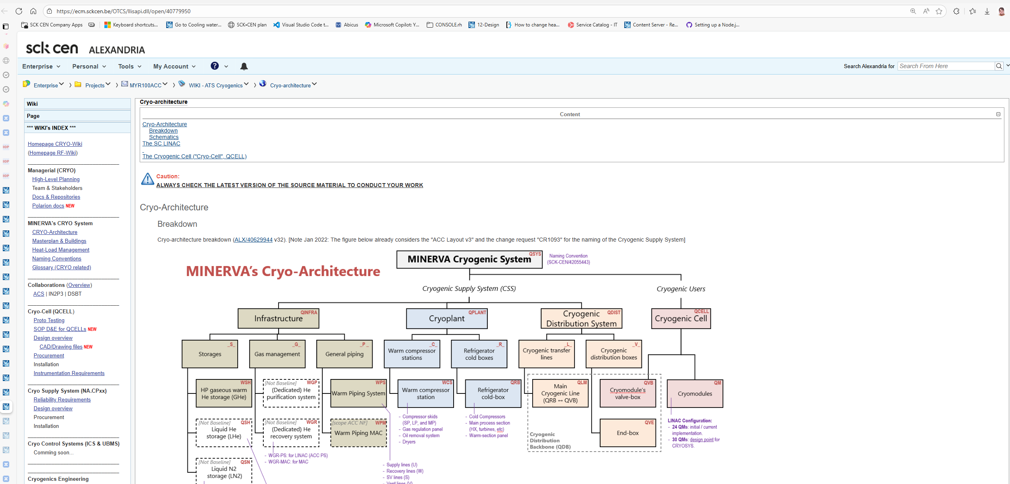
IMPOTANT
IMPOTAN: LOOK at version number - ‘SCK CEN/’ = ‘ALX/’ – internal reference to ALEXANDRIA doc. control

Slide 45
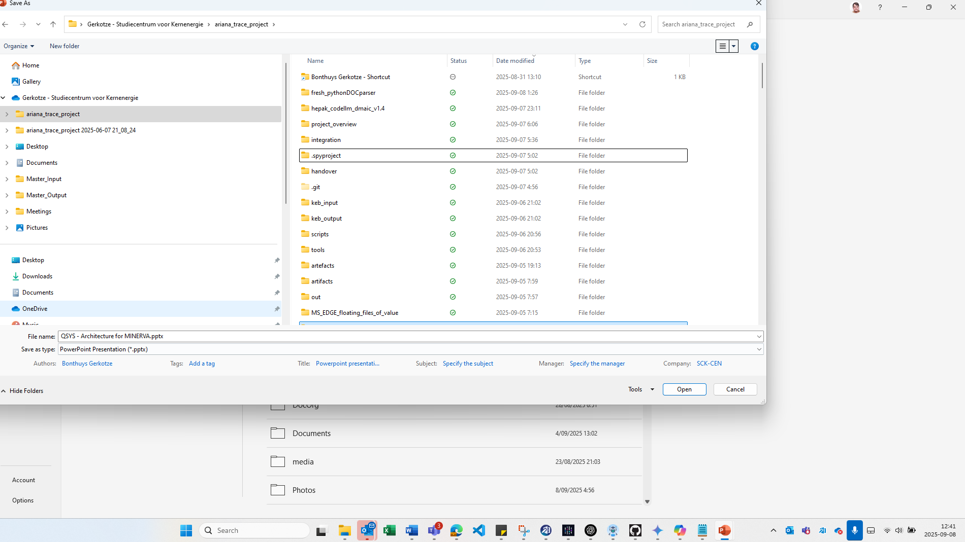

Slide 46
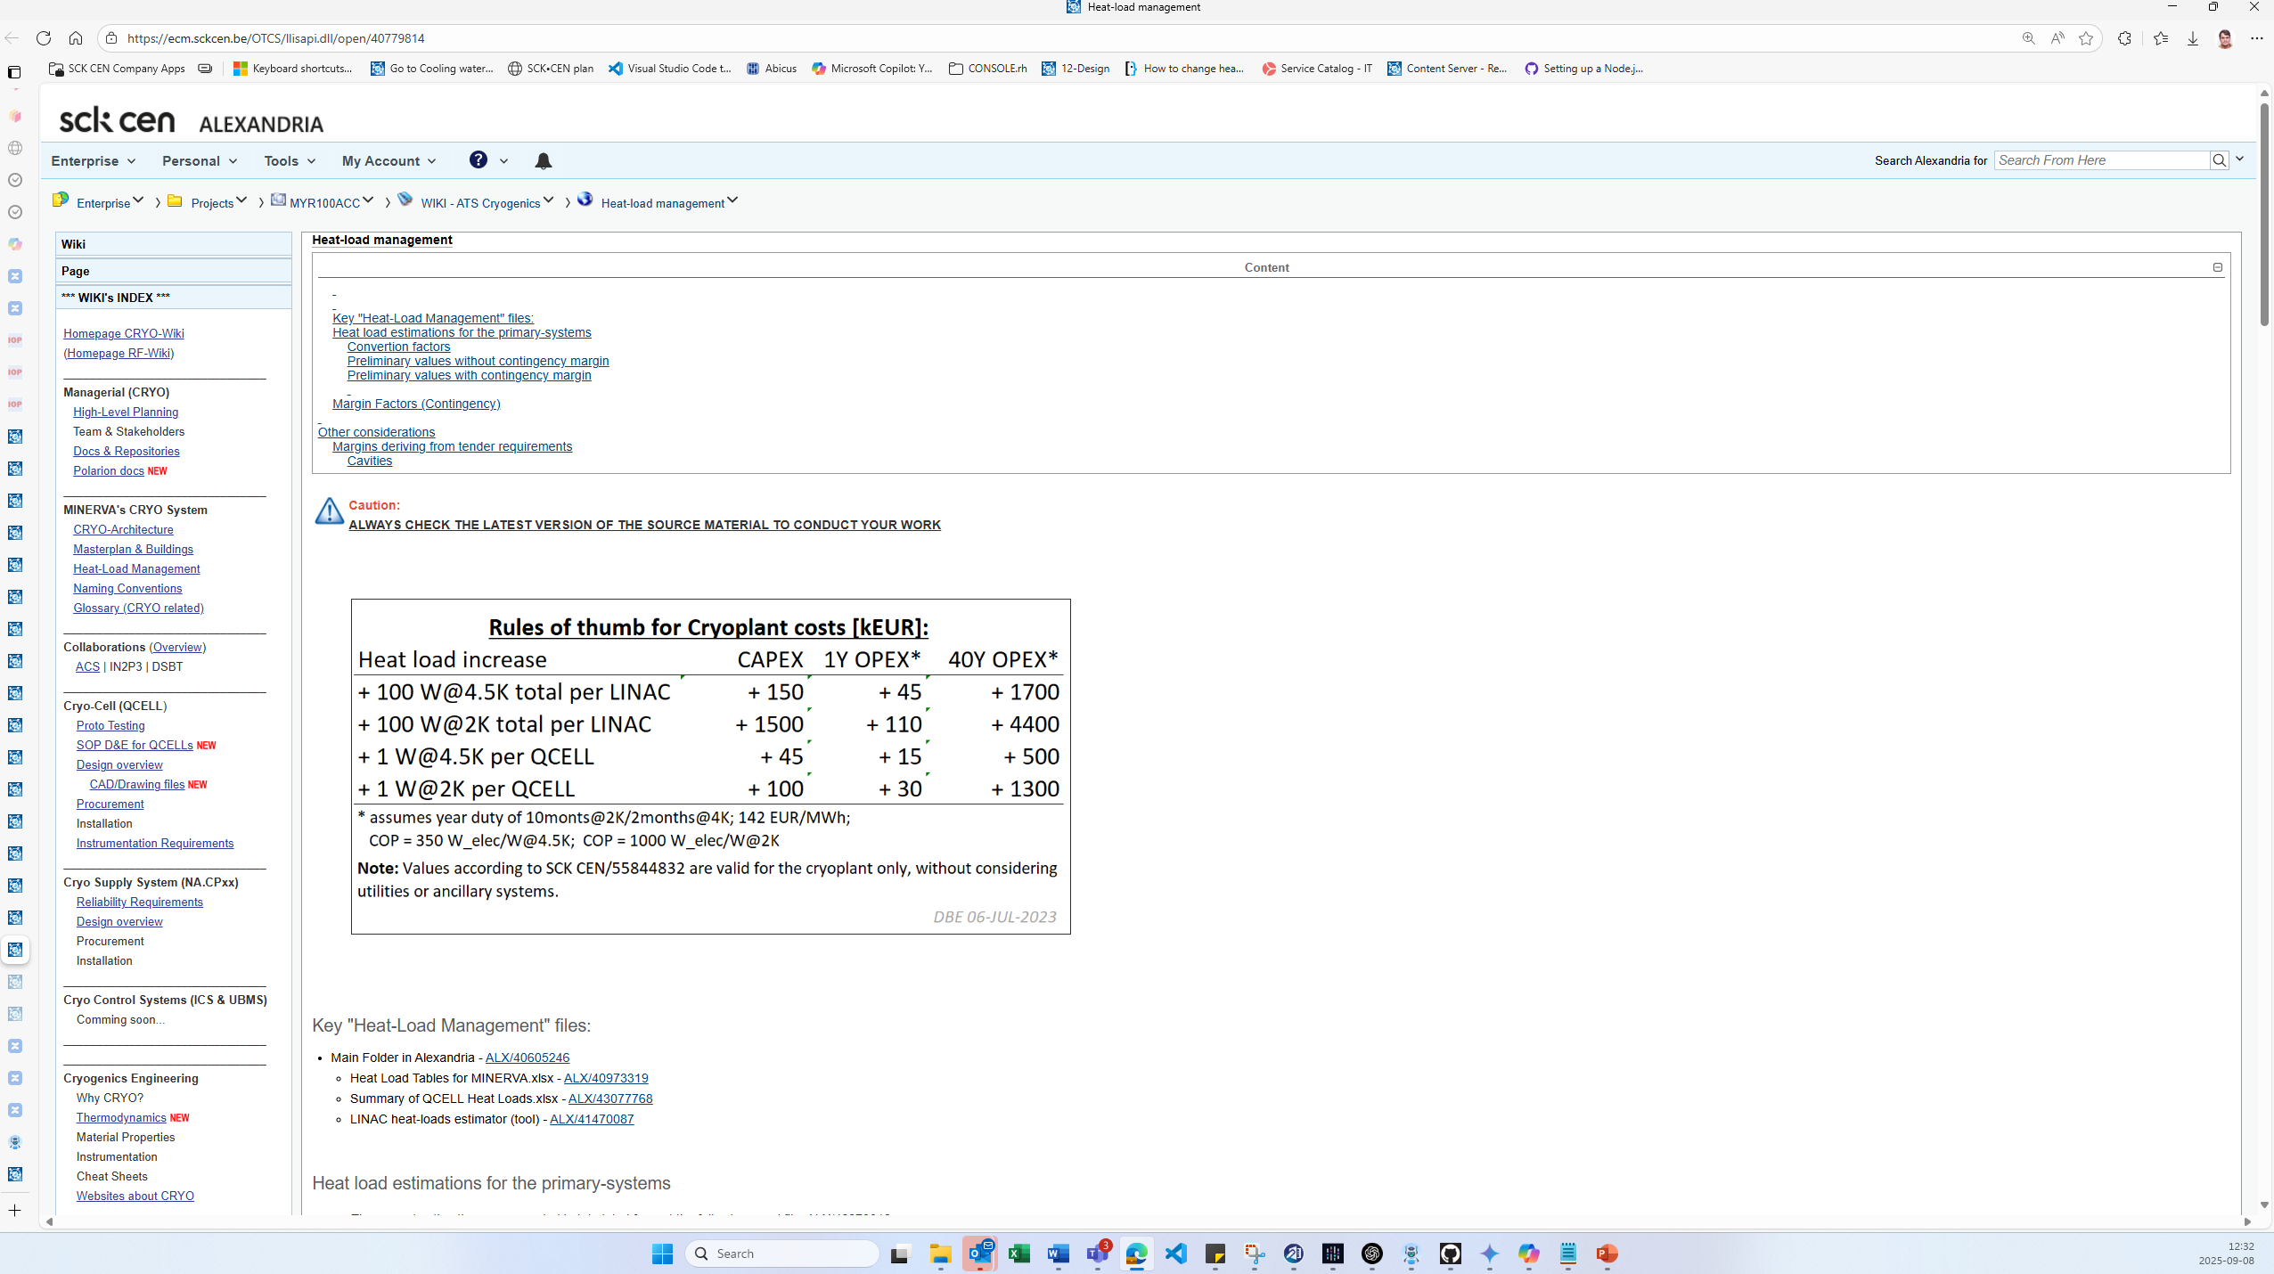

Slide 47
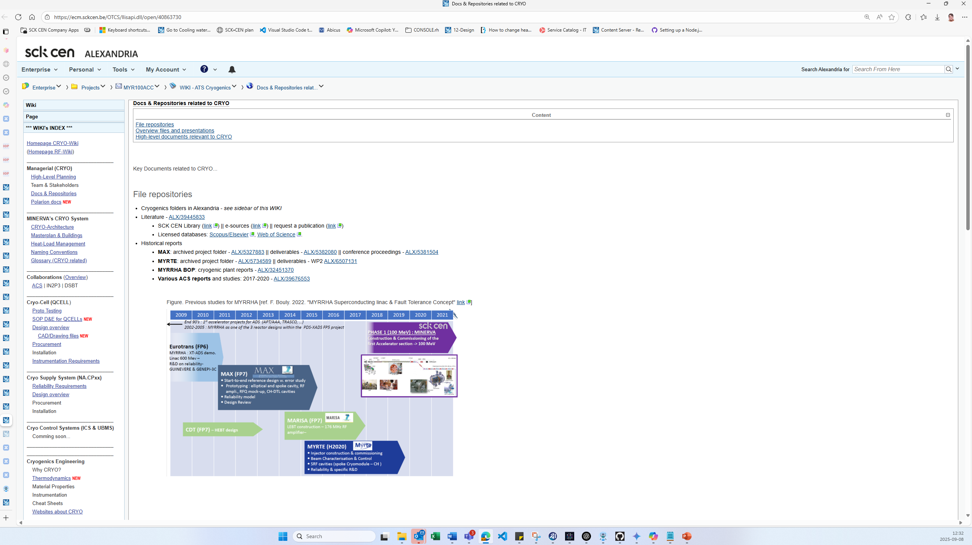

Slide 48
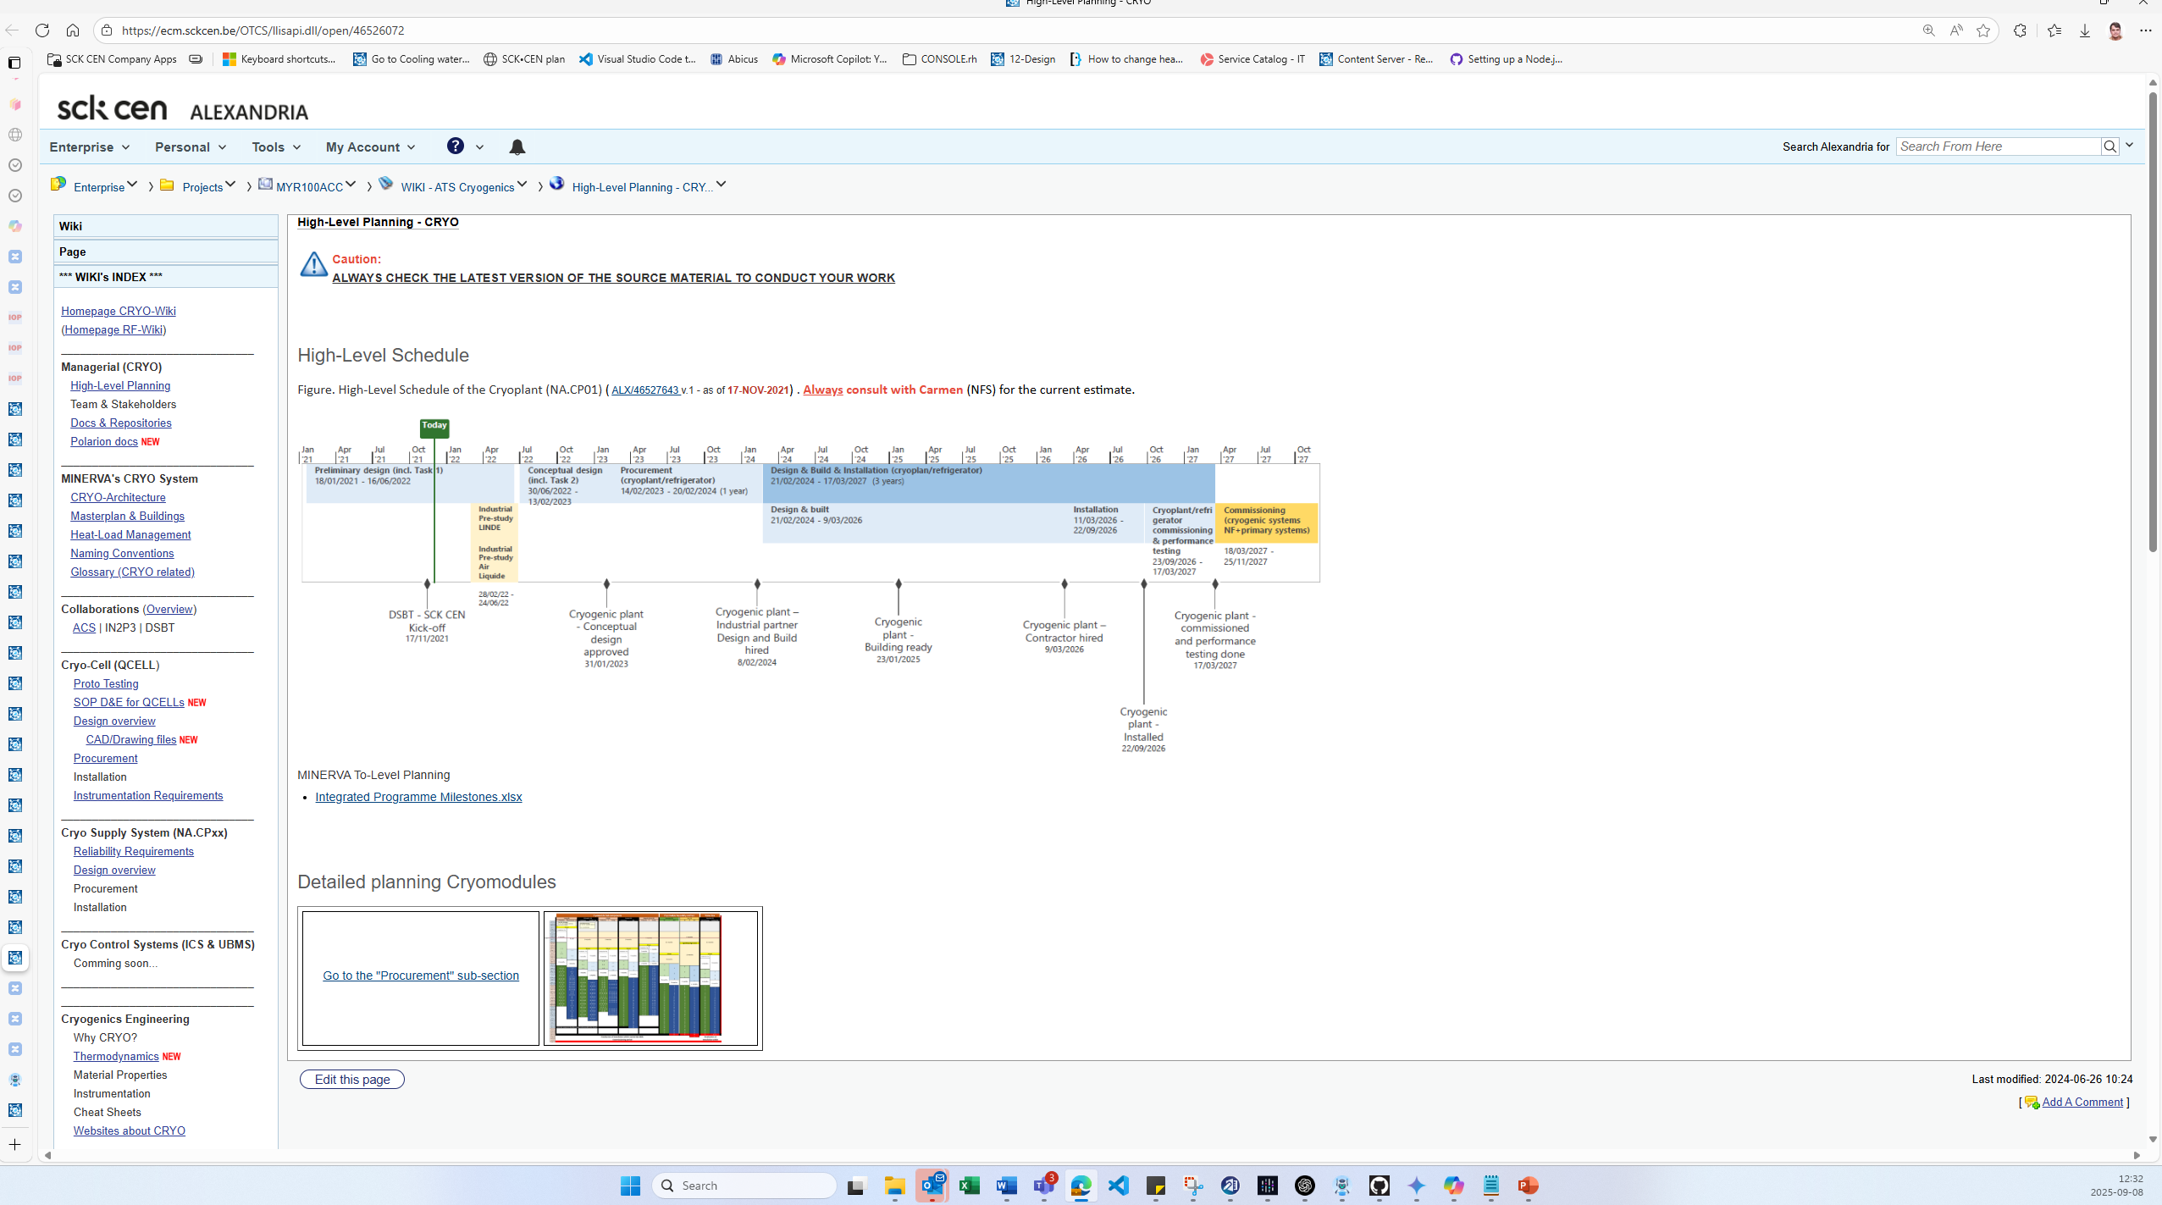

Slide 49
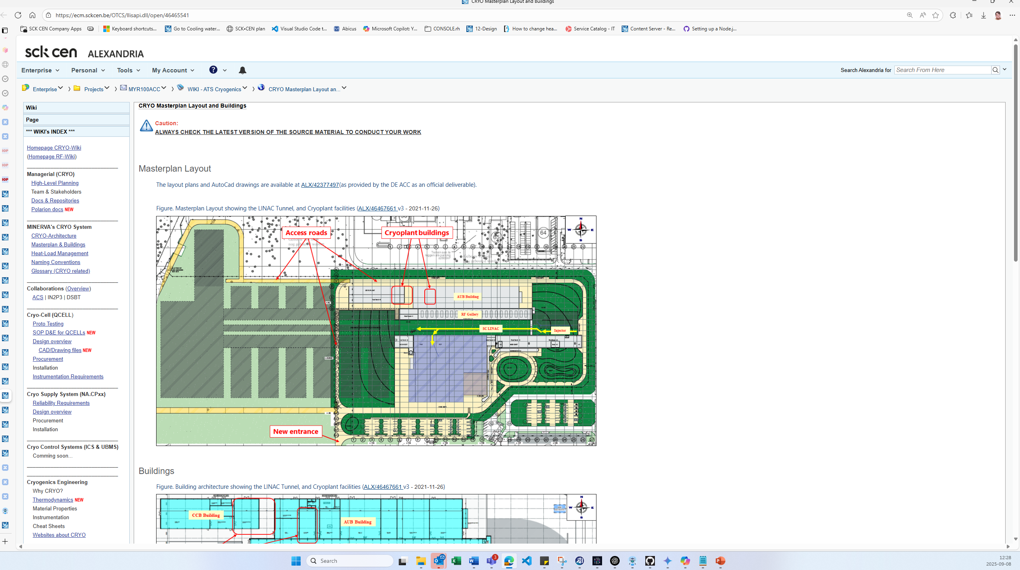

Slide 50
MINERVA Cryogenic System (highly simplified)
Cryoplant & Infrastructure
WCS
QRB
WSH
WSH
WSH
Cryomodules
THINK_OK – blue/orange/pink
QM
QM
QCELL

Slide 51
MINERVA Cryogenic System (highly simplified)
Cryoplant & Infrastructure
WCS
QRB
WSH
WSH
WSH
QLM
WPS
Cryo Backbone
QVB
QVB
QVE
System lifecycle:
Design & Engineering
Procurement & Implementation
Prequalification & Testing
Installation & SAT
Cryomodules
QM
QM
QCELL

Slide 54
MINERVA Cryogenic System (highly simplified)
Cryoplant & Infrastructure
WCS
QRB
WSH
WSH
WSH
QLM
WPS
Cryo Backbone
QVB
QVB
QVE
System lifecycle:
Design & Engineering
Procurement & Implementation
Prequalification & Testing
Installation & SAT
Cryomodules
QM
QM
QCELL

Slide 55
Previous version
Prior 9-9-2024 (NFS to ATS transfer)

Slide 56
MINERVA’s Cryo-architecture (DD MYR-24488)
The Cryogenic Supplier
SBS: L3
NA.CP
Primary systems (Accelerator, ACC PS)
Cryogenic Supply System
Infrastructure
Cryoplant
Cryogenic Distribution System
Storages
Warm compressor stations
Refrigerator cold-box
Cryogenic transfer lines
SC LINAC
Cryogenic Cell
Refrigerator cold boxes
Warm compressor station
Gas management
He recovery system
He purification system
Supply lines (for purging, etc)
Cryogenic distribution boxes
Main refrigerator line (QRB ↔ QLM)
Cryomodule’s valve-box
Cryogenic manifold (QLR ↔ QVB)
HP gaseous warm He storage (GHe)
Liquid He storage (LHe)
Liquid N2 storage (LN2)
General piping and lines
Warm recovery lines
Cryomodules
Vent collector
LN2-storage connection
End-box
Cold recovery line
LHe-storage connection
Naming Convention (SCK-CEN/42055443)
Secondary systems (Nuclear Facilities, ACC NF)
The Cryogenic User
SBS: L4
NA.CP03
NA.CP01
NA.CP02
ACC PS.LB
SBS: L3
_S_
_G_
_P / L_
_C_
_R_
_L_
_V_
QCELL
SBS: L5
WSH
WGR
WPS
WCS
QRB
QLR
QVB
QM
SBS: L4
QSH
WGP
WPR
Compressor skids (SP, LP, and MP)
Gas regulation panel
Oil removal system
Dryers (if not part of purification system)
Cold Compressors
Main process section (HX, turbines, etc)
Warm-section panel
QLM
QVE
For aiding the main process (buffering)
QCELL Definition:
1x QCELL = 1x QM + 1x QVB.
The “MINERVA-ACC-Layout v3” (SCK-CEN/3763312 v.3) foresees QMs with accelerating cavities only:
30 QMs configuration: design point for CRYO.
24 QMs configuration: current implementation.
QSN
WLR
QLV
To assist pre-cooling and/or purification units
QLH
QLN
N.B.: Cryogenic System = “Cryogenic Supplier” + “Cryogenic User”
NA.xx
Utilities ACC
Electrical power (EP)
Compressed air (CA)
Cooling water (CW)
HVAC
NA.ESxx
NA.PS01
NA.PS05
NA.HV03

Slide 57
MINERVA’s Cryo-architecture (NEW Version – work in progress)
SBS: L3
QSUPPLY
User Equipment
Cryogenic Supply System
Infrastructure
Cryoplant
Cryogenic Distribution System
Storages
Warm compressor stations
Refrigerator cold-box
Cryogenic transfer lines
Cryogenic User
Cryogenic Cell
Refrigerator cold boxes
Warm compressor station
Gas management
He purification system
He recovery system
Warm Piping System
Cryogenic distribution boxes
Main refrigerator line (QRB ↔ QLM)
Cryomodule’s valve-box
Main Cryogenic Line (QRB ↔ QVB)
HP gaseous warm He storage (GHe)
Liquid He storage (LHe)
Liquid N2 storage (LN2)
General piping
Warm recovery lines
Cryomodules
Vent collector
LN2-storage connection
End-box
Cold recovery line
LHe-storage connection
Naming Convention (SCK-CEN/42055443)
Supplier Equipment
SBS: L4
QINFRA
QPLANT
QDISTR
QUSER
SBS: L3
_S_
_G_
_P _
_C_
_R_
_L_
_V_
QCELL
SBS: L5
WSH
WGP
WPS
WCS
QRB
QLR
QVB
QM
SBS: L4
QSH
WGR
WPR
Compressor skids (SP, LP, and MP)
Gas regulation panel
Oil removal system
Dryers (if not part of purification system)
Cold Compressors
Main process section (HX, turbines, etc)
Warm-section panel
QLM
QVE
Cryogenic Distribution Backbone (QDB)
QCELL Definition:
1x QCELL = 1x QM + 1x QVB.
The “MINERVA-ACC-Layout v3” (SCK-CEN/3763312 v.3) foresees QMs with accelerating cavities only:
30 QMs configuration: design point for CRYO.
24 QMs configuration: current implementation.
QSN
WLR
Supply lines (U)
Recovery lines (W)
SV lines (S)
Vent lines (V)
QLV
To assist pre-cooling and/or purification units
- Incl. transfer line
For aiding the main process (buffering)
- Incl. transfer line
QLH
QLN
N.B.: Cryogenic System = “Cryogenic Supplier” + “Cryogenic User”
Utilities ACC
Electrical power
Compressed air
Cooling water
HVAC
Insulation Vacuum
NA.ESxx
NA.PS01
NA.PS05
NA.HV03
INVAC

Slide 58
MINERVA’s Cryo-Architecture (NEW Version – work in progress)
QSYS
Naming Convention (SCK-CEN/42055443)
MINERVA Cryogenic System
Cryogenic Supply System (CSS)
Infrastructure
Cryoplant
Cryogenic Distribution System
Storages
Warm compressor stations
Refrigerator cold-box
Cryogenic transfer lines
Cryogenic Cell
Refrigerator cold boxes
Warm compressor station
Gas management
He purification system
He recovery system
Warm Piping System
Cryogenic distribution boxes
Main Cryogenic Line (QRB ↔ QVB)
Cryomodule’s valve-box
HP gaseous warm He storage (GHe)
Liquid He storage (LHe)
Liquid N2 storage (LN2)
General piping
Cryomodules
End-box
Cryogenic Users
QINFRA
QPLANT
QDIST
QCELL
_S_
_G_
_P _
_C_
_R_
_L_
_V_
WSH
WGP
WPS
WCS
QRB
QLM
QVB
QM
QSH
WGR
Supply lines (U)
Recovery lines (W)
SV lines (S)
Vent lines (V)
Compressor skids (SP, LP, and MP)
Gas regulation panel
Oil removal system
Dryers (if not part of purification system)
Cold Compressors
Main process section (HX, turbines, etc)
Warm-section panel
QVE
LINAC Configuration:
24 QMs: initial / current implementation.
30 QMs: design point for CRYOSYS.
[Not Baseline]
Cryogenic Distribution Backbone (QDB)
WGR01: for LINAC
WGR02: for MAC
[Not Baseline]
QSN
To assist pre-cooling and/or purification units
- Incl. transfer lines
For aiding the main process (buffering)
- Incl. transfer lines
Utilities ACC
Electrical power
Compressed air
Cooling water
HVAC
Supporting Systems
Insulation Vacuum
Controls for QCELL
Controls for NA.CP
NA.ESxx
NA.PS01
NA.PS05
NA.HV03
ACC PS/INVAC
CIS or UBMS?
CIS/Cryo Column

